Slide 1
Economic Realities & the 1:2:7 Skilled Job Ratio
#CTEMonthMN | www.minnstate.edu/system/cte/index.html | February 2018
Notes:
SCRIP SUGGESTION:
Introduce yourself and/or this presentation’s topic. Provide context of how this presentation fits with other information students have received about career exploration, career planning and/or Personal Learning Plans.
NOTES:
Public and nonprofit Presenters/Educators/Advisors have permission to customize/edit these slides to use with students.
Original PowerPoint created by:
Denise Felder, Minnesota State Colleges & Universities
2018
Use this PowerPoint as part of your career and college readiness curriculum.

Slide 2
The key to finding a high-paying career is … Going to College?
True or False:
True … Sort of …
Notes:
SCRIPT SUGGESTION
Lead discussion on why the answer is “sort of.” What are their guesses for the reason.
Lead discussion about what students have been told about the link between college and career.
NOTE
Use this and/or other quiz questions to interact with audience and gauge their perceptions about college and the job market.

Slide 3
The real key to finding a high-paying career is not just going to college, but the type of college degree (or postsecondary credential) you earn.
Notes:
SCRIPT SUGGESTIONS
Discuss how economic and job market changes require postsecondary education to qualify for high-paying jobs. Did student’s parents graduate from college in order to get a good job? Did their grandparents? What is the connection between postsecondary education and high-wage employment in other countries?

Slide 4
Postsecondary Credentials
2- or 4-year Degree
Certificate
Licensure
Apprenticeship
Military Programs
College Diploma
Notes:
SCRIPT SUGGESTIONS:
Any type of formal training or education program after high school is needed to qualify for middle and high skill careers. Jobs that used to ask for only a high school diploma now require an associate’s degree, a college certificate or an industry recognized credential like becoming an apprenticeship journeyman.
Lead discussion about what a “middle skill” job is.
“Middle-skill jobs, which require education beyond high school but not a four-year degree, make up the largest part of America’s and Minnesota’s labor market. Key industries in Minnesota are unable to find enough sufficiently trained workers to fill these jobs. “ Source: https://www.nationalskillscoalition.org/resources/publications/2017-middle-skills-fact-sheets/file/Minnesota-MiddleSkills.pdf
NOTES:
Definition of Higher Education Postsecondary education at colleges, universities, junior or community colleges, professional schools, technical institutes, and teacher-training schools.
Definition of Postsecondary Education A formal instructional program which curriculum is designed primarily for students who have earned a high school diploma or the equivalent. Includes two-year colleges and four-year colleges and universities as well as academic, vocational, and continuing professional education programs. Also called higher education. Source: CareerWise https://careerwise.minnstate.edu/info/glossary.html
Apprenticeship information: https://careerwise.minnstate.edu/education/apprenticeships.html
Military options: https://careerwise.minnstate.edu/careers/military.html

Slide 5
More U.S. jobs require which types of degrees?
The most lucrative type of degrees might surprise you.
Watch the 9-minute video Success in the New Economy for a full explanation of what young people need to know about the labor market.
Notes:
NOTES:
Transcript of video http://www.citruscollege.edu/academics/cte/Documents/Success-in-the-New-Economy.pdf
Video is free to play on YouTube. Click on image or text to start the video.

Slide 6
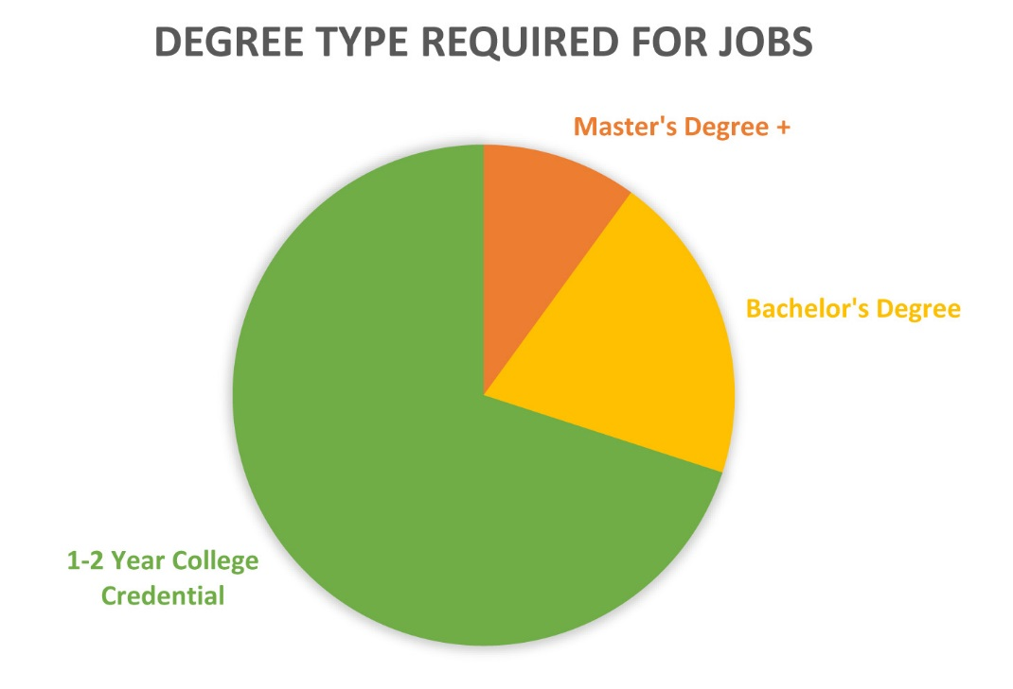
More U.S. jobs require which types of degrees?
“The true ratio of jobs in our economy is 1:2:7.”
- Kevin Fleming, Success in the New Economy
Notes:
SCRIPT SUGGESTION
Lead discussion about the video – What did you think? What stood out for you in the video? What surprised you? Can you explain the 1:2:7 ratio in your own words?
NOTES
Slides 6-9 give the same information with different visuals. Choose 1-2 of these slides to use.
1-2 year college credential includes college diplomas, certificates, associate degrees, and apprenticeship.
Middle skilled jobs in Minnesota fact sheet: https://www.nationalskillscoalition.org/resources/publications/2017-middle-skills-fact-sheets/file/Minnesota-MiddleSkills.pdf

Slide 7
What is the 1:2:7 Ratio?
For every occupation that requires a master’s degree or more …
Two professional jobs require a university degree, and …
There are over half a dozen jobs requiring a 1-year college certificate or 2-year degree.
Notes:
SCRIPT SUGGESTIONS
Ask audience or give examples of occupations that require a master’s degree or professional degree for entry. Ask for examples of jobs requiring bachelor’s degree. Ask or give examples of jobs requiring 1-2 year degree.
NOTES
Slides 6-9 give the same information with different visuals. Choose 1-2 slides to use.
Give information about careers students are interested in, or about top careers in your region: https://careerwise.minnstate.edu/careers/viewCareers?id=00

Slide 8
Source: www.explorethetrades.org
Notes:
SCRIPT SUGGESTIONS
Ask audience or give examples of occupations that require a master’s degree or professional degree for entry. Ask for examples of jobs requiring bachelor’s degree. Ask or give examples of jobs requiring 1-2 year degree.
NOTES
Slides 6-9 give the same information with different visuals. Choose 1-2 slides to use.
Give information about careers students are interested in, or about top careers in your region: https://careerwise.minnstate.edu/careers/viewCareers?id=00

Slide 9
In Other Words …
33% of U.S. jobs require a Bachelor degree or higher
57% require skilled labor (two years or less college credential).
Notes:
SCRIPT SUGGESTIONS
Ask audience or give examples of occupations that require a master’s degree or professional degree for entry. Ask for examples of jobs requiring bachelor’s degree. Ask or give examples of jobs requiring 1-2 year degree.
NOTES
Slides 6-9 give the same information with different visuals. Choose 1-2 slides to use.
Give information about careers students are interested in, or about top careers in your region: https://careerwise.minnstate.edu/careers/viewCareers?id=00

Slide 10
The 1:2:7 Skilled Job Ratio
The kinds of jobs change over time – the U.S. needed more factory workers and farmers in the past – but the need for skilled labor or “middle skilled” workers remains high in every state.
Notes:
SCRIPT SUGGESTIONS
Give information about careers students are interested in, or about top careers in your region: https://careerwise.minnstate.edu/careers/viewCareers?id=00
NOTES
“Middle-skill jobs, which require education beyond high school but not a four-year degree, make up the largest part of America’s and Minnesota’s labor market. Key industries in Minnesota are unable to find enough sufficiently trained workers to fill these jobs. “ Source: https://www.nationalskillscoalition.org/resources/publications/2017-middle-skills-fact-sheets/file/Minnesota-MiddleSkills.pdf

Slide 11
The 1:2:7 Skilled Job Ratio
A high number of middle-skilled jobs are in health care, and/or use all types of computers and emerging technologies.
Notes:
SCRIPT SUGGESTIONS
Talk about the many career options in health care – can have an interesting job at a hospital, clinic or lab that does not take as long in school as becoming a doctor or RN.
Think about all the medical professional in an operating room. The technicians are highly skilled, interesting jobs.
NOTES
Give activity during or after presentation where students research occupations in health care and/or occupations using computer technology skills.
Give activity where students find at least one occupation in each career cluster that requires strong computer skills.

Slide 12
Examples of Middle-Skilled Jobs
www.explorethetrades.org

Slide 13
Examples of Middle-Skilled Jobs
Some MN occupations requiring an Associate’s degree or College Certificate and pay $23 an hour or more:
Computer Network Support Specialists
Dental Assistants
Electrical and Electronic Engineering Technicians
Heating, Air Conditioning, and Refrigeration Mechanics and Installers
Medical Laboratory Technicians
Surgical Technologists
Telecommunications Equipment Installers and Repairers
Web Developers
Source: www.careerwise.mnscu.edu
Notes:
SCRIPT SUGGESTIONS
NOTES
Use Careerwise, MCIS, CareerOneStop or another source for students to find occupations of interest to them – look at education needed for entry, growth rate and/or number of openings, and beginning and median pay.

Slide 14
How Can 1:2:7 Work For You?
Think about which careers you might want to pursue.
Look at what type of degree or credential is needed to get an entry-level job in the career(s) you are interested in.
Choose a postsecondary program or school that fits your goals.

Slide 15
How Can 1:2:7 Work For You?
The key to finding a high-paying career you like is not to just go to college, its earning the right type of degree or certificate that meets your goals.

Slide 16
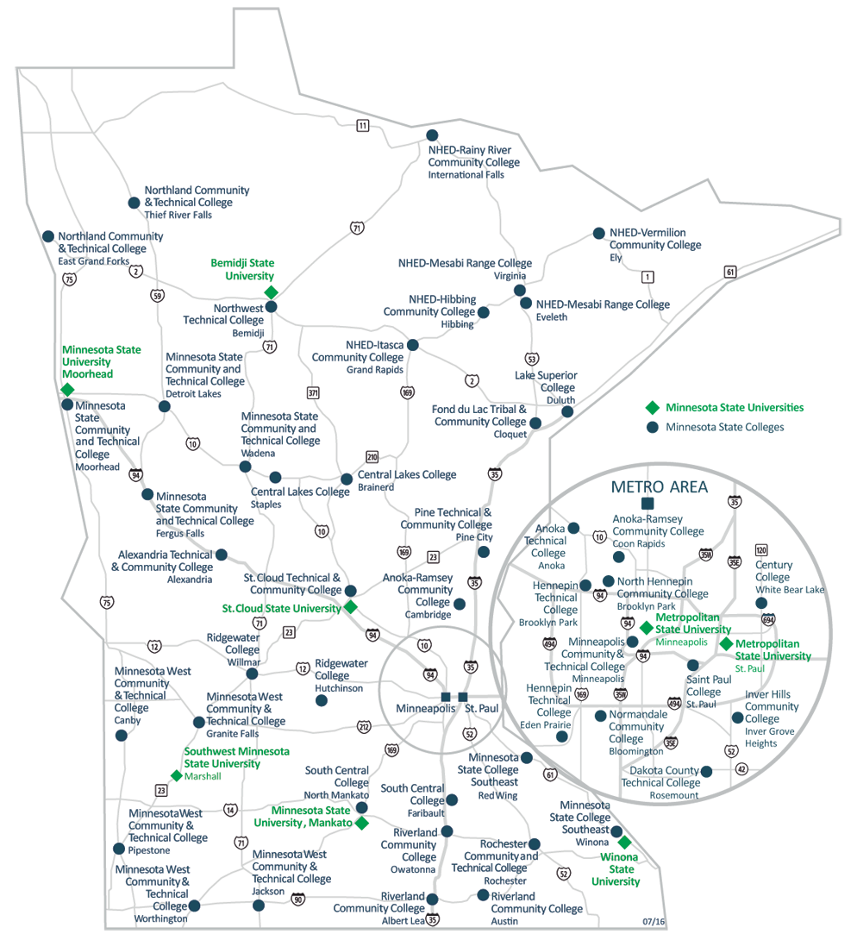
Minnesota State Colleges & Universities
Explore all the certificate and degree programs offered at Minnesota State’s 30 colleges and 7 universities.
http://minnstate.edu/colleges/campuses.html
Notes:
SCRIPT SUGGESTIONS
College is like ice cream with lots of different flavors. Think about whether you want to go to a two year school or 4-year university – remember you can transfer if the school is not the right fit for you. Also think about whether you want to go to college close to home or several hours away. Do you want to live on campus in a dorm, in an apartment near school, or live at home? Are campus activities important to you like participating in intermural sports, joining clubs, participating in theater, and other social events?
Once you have narrowed your choices of colleges to 3-5 campuses, visit each college in person or take a virtual tour. Visiting in person is best so you can literally feel if you fit in on the campus and ask questions of current students and of the faculty and staff. Visit the website for each of your top schools to get more information about visiting.
NOTES
Colleges outside of Minnesota can be explored on CareerOneStop (https://www.careeronestop.org/Toolkit/Training/find-local-training.aspx) or College Boards’ Big Future (https://bigfuture.collegeboard.org/find-colleges).

Slide 17
Notes:
NOTES
PowerPoint developed by Denise.Felder@MinnState.edu, 2018

