Slide 1



Slide 2

Welcome
The presentation will begin shortly
If using your phone, connect to the meeting first then dial in. If you are experiencing audio problems, disconnect the PC audio and try again

Slide 3
August 2017
TAX SERVICES
International Employees & Visitors
Tax Compliance Issues
Notes:
WELCOME EVERYONE
My name is Ann Page
I am the Tax Specialist for the Minnesota State system also with us today is Steve Gednalske, System Director of Tax and Financial Services
Before we get started I am going to mute all your microphones
However I want you to please feel free to ask questions during the presentation
To ask a question, unmute yourself by clicking on the microphone icon -when you are finished, please remute your mic
Please take a moment to make sure you are able to unmute and remute yourself.
If anyone is experiencing problems with their microphones try IM’ing me your questions instead
We will be recording this presentation and making it available

Slide 4

Goals for Today
Awareness of nonresident alien tax issues
Identification of nonresident employees
Who to call:
  Tax Services, Steve Gednalske or Ann Page
  Steven.Gednalske@minnstate.edu
  651-201-1657
  Ann.Page@minnstate.edu
  651-201-1730
  Tax Services Website
Notes:
Our goals for today are a general awareness of nonresident alien tax issues, how to identify when you have a nonresident employee and who to call for help
before we delve into the nitty gritty details, I am going to give an over view of the tax concepts which are applicable to all payments made to international persons and entities

Slide 5




Tax Residency
What is it?
Why we care
Notes:
Everything we will be discussing today comes from the concept known as tax residency
So what is tax residency and why do we care

Slide 6

Tax Residency – What is it?
US has two systems of taxation
  Residents
  Nonresidents
Notes:
In the US there are 2 systems of taxation –
Residents = taxed on their world wide income – residents include US citizens, green card holders, and resident aliens
Nonresidents = taxed only on their US sourced income – BUT at a higher rate and up front – we must gather the tax at the time we make the payment
Because of this we must know prior to payment who we are paying – are they a nonresident or a resident?

Slide 7

Tax Residency - Why We Care
MN State
Colleges
& Universities
Pay
We may be held responsible for taxes not withheld and penalties & interest for failure to withhold
Notes:
Why do we care? For two reasons – one, we be held responsible for failure to withhold if we do not apply the correct tax treatment the IRS goes after us first - not after the person we made the payment to
And 2, Noncompliance can also harm our international visitor – failure to comply with US tax law may jeopardize their current and/or future US immigration status

Slide 8

Tax Residency – Who? How?
Who is a nonresident?
Substantial Presence Test
  Immigration Status
  Date status began
  Days in the US current visit
  Purpose of visit
  All of the above for all prior visits to the US
Notes:
So there are 2 systems - How do we know which one to apply?
Who is a nonresident alien?
If you are not a US citizen or permanent resident alien (green card holder), you are either a nonresident alien or a resident alien for tax purposes
In order to determine which, we have to apply the IRS Substantial Presence test – The SPT is a mathematical calculation of days present in the US used to determine tax residency
An int’l will be considered a resident for tax purposes if they meet the SPT for the calendar year.
to apply the Substantial Presence Test We must gather information
Immigration Status
Date status began
Days in the US current visit
Purpose of visit
All of the above for all prior visits to the US

Slide 9
Tax Residency – SPT
To meet this test, the int’l must be physically present in the US on at least:
31 days during the current year, and
183 days during the 3-year period that includes the current year and the 2 years immediately before that, counting:
  All the days you were present in the current year, and
  1/3 of the days you were present in the first year before the current year, and
  1/6 of the days you were present in the second year before the current year.
Notes:
To meet this test, they must be physically present in the US on at least:
31 days during the current year, and
183 days during the 3-year period that includes the current year and the 2 years immediately before that, counting:
All the days you were present in the current year, and
1/3 of the days you were present in the first year before the current year, and
1/6 of the days you were present in the second year before the current year.
If that’s all there is to it – why did we need to

Slide 10

Tax Residency
Why?
  Immigration status
  Visits more than 3 years ago
Exceptions to the Substantial Presence Test
Notes:
Seems pretty straight forward doesn’t it? Remember this is the IRS – nothing is simple or straight forward –
There are the Exceptions to the Substantial Presence Test based on immigration status – for int’ls present under F, J, M and Q immigration status the SPT is calculated differently
We need to know information about all their previous visits to the US in order to determine their current tax residency

Slide 11

Fact Gathering For Tax Residency Determination
Notes:
I’m not going to get any further into the nitty gritty of applying the Substantial Presence test – instead I want to concentrate on the fact gathering process

Slide 12
Gatekeepers
{
The Players
  Administration
  Faculty/Departments
  Human Resources
  Financial Aid
  Business Office
  International Office
Type of Payment
  Employee Compensation
    State
    Student
  Scholarships
  Vendor Payments
    Services
    Honoraria
Notes:
The Players
Administration – increasingly our college & university administrations are embracing global studies and seeking ways to expose our students to the world outside the US
Faculty/Departments – professors are often the first point of contact with the international that is coming to our campus
Human Resources – may be the employee’s first contact
Financial Aid – often involved with student employment as well as scholarships
Business Office – charged with correctly taxing payments made to nonemployees and with sending tax payments to Tax office
International Office – involved in reporting and tracking international students and scholars
To achieve compliance we have to break out of the silo mentality and work together

Slide 13

Fact Gathering
Identify
Who What Why When Where
  Who are we paying?
  What type of payment?
  When?
  Why?
  Where?
    Sourcing of funds
Notes:
The fact gathering process for all payments to internationals starts with first identifying that you are dealing with an international
Followed by answering questions about the international and about the payment being made

Slide 14
Fact Gathering
Identify there’s a Situation
  International Office
  I-9 Form
  Employee identification
  Vendor
    W-8 series
Notes:
First step to compliance is knowing that you are paying an international
All parts of the campus have to work together for students and visiting scholars the campus international office knows first.
For employees, HR or the Department, whoever is responsible for gathering the I-9 form – a properly completed I-9 will identify if you are dealing with a nonimmigrant, and I-9 documents may provide immigration status, country, dates of stay
For non employees – SWIFT set up & W-9; self identify because they may not complete W-9 or completed a W-9 incorrectly which should lead accounts payable to

Slide 15
Fact Gathering
Who are we paying?
  Entity type
  Immigration status
  Purpose of their visit
  Country of citizenship
Notes:
Entity type – are we paying a person or a company? Is it a corporation or non profit
If a person:
Immigration status: what type of visa are they present in the country under? The type of visa (or more properly immigration status) will determine whether the person may be legally paid
Purpose of Visit: Why are they in the US? To study? For a cultural exchange program? For training? As a scholar? As a business visitor?
Where are they from?

Slide 16

Fact Gathering
What type of payment?
  Scholarship
  Services
  Employee Compensation
  Honorarium
  Royalties
Notes:
What are you paying for?
Is it a scholarship or grant to defray the cost of education or research?
Is it a payment for Services? Is it a speaker or performance fee or some kind of professional service?
Is the payment employee compensation?
Are you paying an honorarium?
Royalties: Are you purchasing a software license?

Slide 17

Fact Gathering
Why is the int’l on campus?
  Academic purpose of payment
When did the int’l arrive?
  How long will the international be performing services on your campus?
Notes:
Why is the international on your campus
What is the purpose of their visit
How long will they be performing services on your campus
How long will they be in the US
How many other educational institutions are they visiting

Slide 18
Fact Gathering
Where – US or Foreign Sourced
Summary of Source Rules for Income of Nonresident Aliens
Item of Income | Factor Determining Source
Salaries, wages, other compensation | Where services are performed
Business income: Personal services | Where services are performed
Royalties: Patents, copyrights, etc. | Where property is used
Scholarships - Fellowships | the residence of the payer and the location of the academic activity
Notes:
Where – Sourcing of Funds
Whether the funds are US or Foreign sourced will determine our withholding and reporting responsibilities – different types of payments have different sourcing rules
Wages and payments for services: if the services are performed in the US they are US sourced income subject to US tax withholding and reporting
Royalties: where the property is used – if we buy photo rights from a Chinese artist to use in a college catalog = US sourced
Scholarships: if US payer to a student at a US institution = US sourced

Slide 19

Taxation of International Employees
Notes:
So that’s the overview – I want you to understand the scope of information needed to determine tax residency and who on your campus you may need to work with to gather the necessary information

Slide 20
Taxation of International Employees
Identifying Foreign Hires
Tax Residency Information Form & Documentation
Taxing Nonresident Alien Employees
Notes:
Identifying Foreign Hires –
Tax Residency Information Form & Documentation
Taxing Nonresident Alien Employees

Slide 21

Identifying Foreign Hires
  State Employees
  Student Employees

Slide 22
Identifying NRA Employees: I-9
I-9 : “An alien authorized to work until…” must fill out Tax Residency Information form
✗
Notes:
The line of first defense so to speak is Section 1 of the I-9 Employment Eligibility Verification
When an employee marks Box 4 in Section 1 we must determine if their tax residency status – are they a resident alien or a nonresident alien for tax purposes

Slide 23
Tax Residency Information Form aka TRIF
Employee’s who indicate on their I-9 that they are “an alien authorized to work until…” must fill out the Payroll Tax Residency Information form.
The data collected on this form will help determine an employee’s tax residency status
Notes:
If the new hire marks box 4 in Section 1 of the I-9, they must complete our internal Tax Residency Information Form
There is a Tax Residency Information form for state ee and one for student employees – both forms ask for the same information that is needed to determine the employee’s tax residency

Slide 24

Tax Residency Substantial Presence Test Data
Country of Citizenship
Current Immigration Status
Date of Arrival for Current Visit
Number of Days in the US
Primary Purpose of Visit
Information about Prior Visits including the above facts
Notes:
The Tax Residency Information Form is asking for the Substantial Presence Test data
Remember back at the beginning of the presentation – The substantial presence test is the mathematical calculation of days present in the US that determines if an int’l is a resident or nonresident for tax purposes
We need to know
Country of Citizenship
Current Immigration Status
Date of Arrival for Current Visit
Number of Days in the US
Primary Purpose of Visit
Information about Prior Visits including the above facts

Slide 25
Sections of Tax Residency Information Form
Personal Information
  Current Immigration Status
  Date Current Status Began
Prior Visit Information
  Visits to the U.S. before Date Current Status began: when, immigration status, # of days, & purpose of visit
Employee Certification
Tax Residency Calculation & Date

Slide 27
TRIF = Personal Information

Slide 28
TRIF = Prior Visit Information

Slide 29
TRIF = Tax Residency Year
2019
Notes:
Mei Lee signs the form to certify that the information she has provided is accurate
There’s a section for calculating the employees tax residency status. For state paid employees this section will be completed by Tax Services – In this example I took the information provided by Mei Lee on the form and applied the SPT to determine when we can start treating her as a resident alien for tax purposes – when we can start treating her the same as a US citizen. In this example her tax residency start date is 1/1/2019 – we will begin taxing her as a resident on that date. Until then we must tax her under the nonresident alien taxation rules.
Once Tax Services has completed the form, we will provide a copy to the campus and if employee is currently a nonresident alien for tax purposes we send a copy of the form and the immigration documents that support the form to MMB

Slide 31
TRIF = Personal Information

Slide 32
TRIF = Prior Visit Information

Slide 33

TRIF = Tax Residency Year
Notes:
On the Student Payroll Tax Residency Information form the calculation section is a formula that is completed by the campus – this is different from the regular employee form because students that are present under F-1 or J-1 immigration status are considered to be nonresidents for tax purposes for the first 5 years that they are present under F or J status in the US. Any part of a year that they were present as an F1 or J1 student previously or as a dependent of an F1 or J1 student previously, counts as one of the first 5 years. So this section is set up so that we add 5 years to the year they first arrived under their current student status, and subtract away the years that they were here previously

Slide 34
TRIF Documentation
  State Employees
  Student Employees
Notes:
In many cases the same documents that are presented for I-9 verification are the documents that we need to verify identity and immigration status
DO NOT KEEP THE I-9 form with the TRIF documentation

Slide 35
Documentation – State EE
Copy immigration documentation
  Passport unexpired
  I-94, arrival/departure record
  Immigration Status documentation
    I-20, F-1 student on OPT
    DS-2019, J-1 (student or scholar)
    H-1B Approval Letter
    Invitation and Employment Letters
Employment Authorization Cards (front and back)
  Any other immigration documentation presented by the payee
Notes:
Unexpired Passport – identification page and all pages related to travel into the US
I-94, arrival/departure record -
Immigration Status documentation
I-20, F-1 student on OPT
DS-2019, J-1 (student or scholar)
H-1B Approval Letter
Invitation and Employment Letters

Slide 36

Documentation – Student EE
F-1 Students
I-20 SEVIS
I-94
Passport unexpired
J-1 Students
DS-2019 & Employment Letters
I-94
Passport unexpired

Slide 37
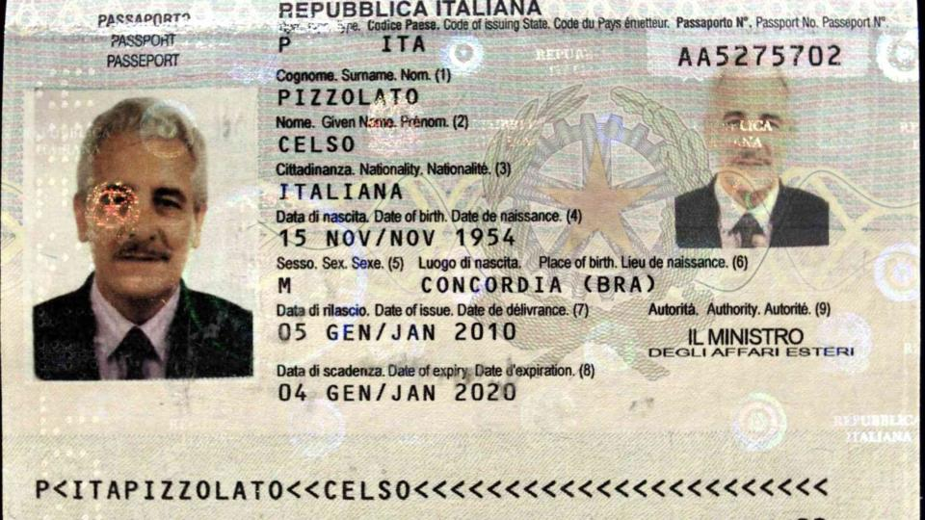
Passport Information
Unexpired Foreign Passport
Notes:
All the information necessary for retrieving the I-94 can be found on the international visitor’s passport
First and Last Names
Date of Birth
Passport Number
Country

Slide 38
I-20
Certificate of Eligibility for Nonimmigrant (F-1) Student
Notes:
For an F-1 student, the same three documents that are used to verify identity and employment eligibility are used to document tax residency status
*I-20
*I-94
*unexpired foreign passport

Slide 39
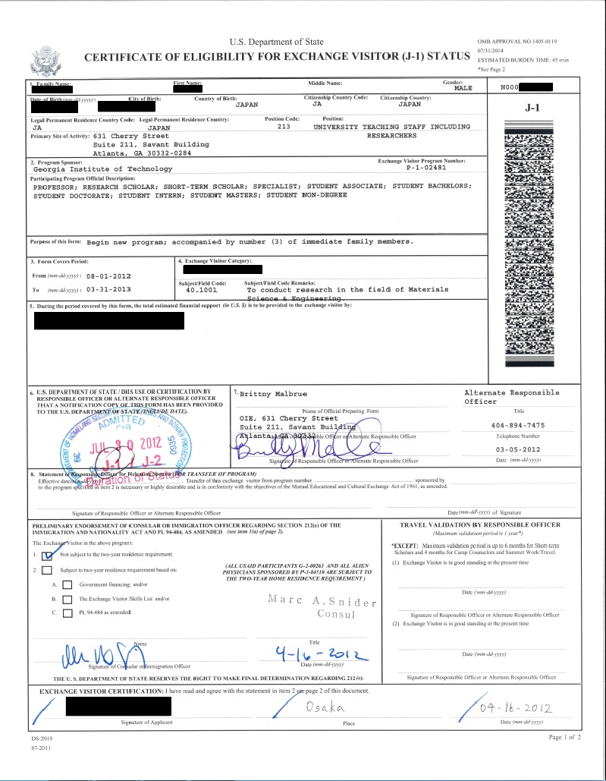
DS-2019
Certificate of Eligibility for Nonimmigrant Under J-1 Status
Notes:
For an F-1 student, the same three documents that are used to verify identity and employment eligibility are used to document tax residency status
*I-20
*I-94
*unexpired foreign passport

Slide 40
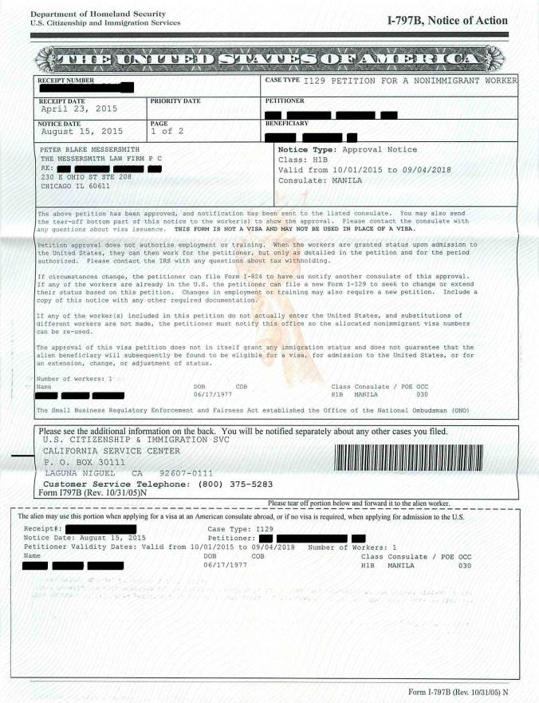
I-797B
Notice of Action
H-1B
Notes:
For regular state employees present under H-1B status request a copy of their I-797B Notice Of Action which will state who their employer is
H1B may only work or accept payments from the sponsoring employer

Slide 41
Online I-94
How to retrieve an I-94 arrival/departure record
  Go to the US Customs & Border Protection I-94 webpage:
  https://i94.cbp.dhs.gov
Enter information from passport
Only transmitted for air and sea travelers, CBP will still issue a paper form I-94 at land border ports of entry.

Slide 42
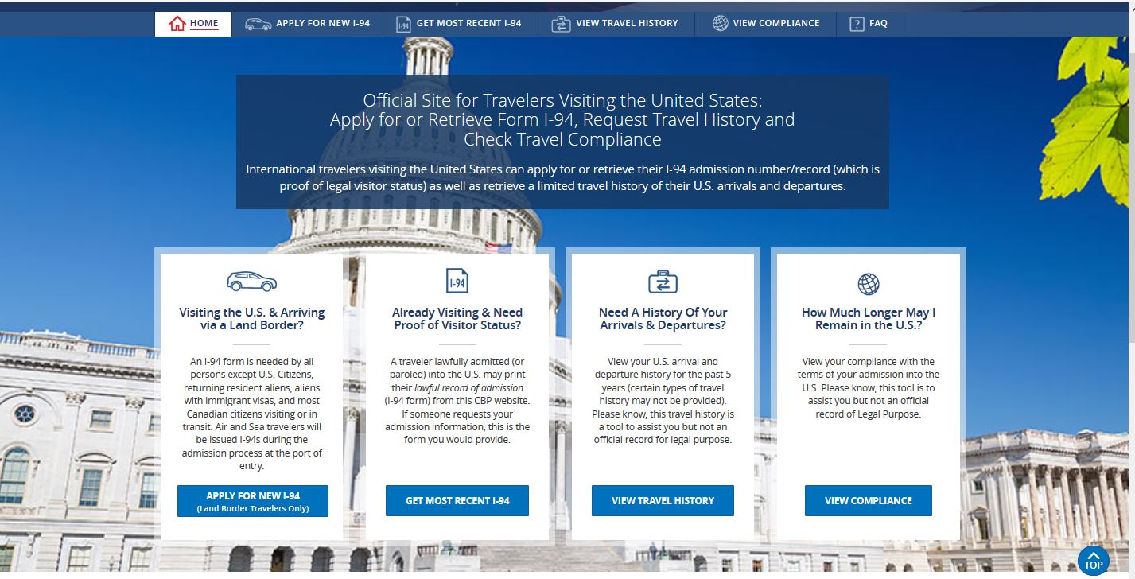
I-94: US CUSTOMS & BORDER PROTECTION WEBSITE

Slide 43
Passport Information
All the information necessary for retrieving the I-94 can be found on the international visitor’s passport
Notes:
All the information necessary for retrieving the I-94 can be found on the international visitor’s passport
First and Last Names
Date of Birth
Passport Number
Country

Slide 44
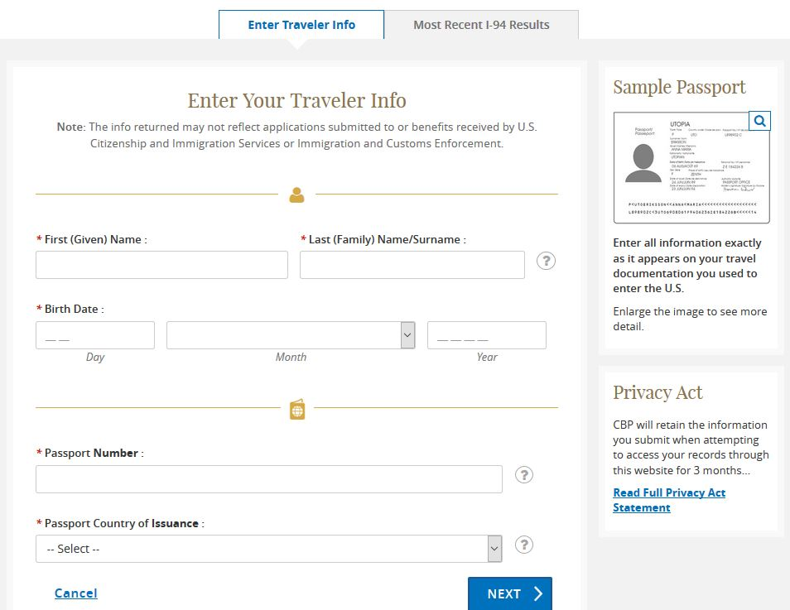
I-94: US CUSTOMS & BORDER PROTECTION WEBSITE

Slide 45
I-94 ADMISSION RECORD
US CBC Arrival/Departure Record
  Issued to international visitors admitted into the U.S.
Notes:
All foreign visitors will have an I-94 record The I-94 verifies immigration status, length of stay and country of citizenship

Slide 46
I-94 TRAVEL HISTORY
US CBC Arrival/
Departure
Record
  Travel History
Notes:
When you retrieve the I-94 also retrieve the I-94 travel history to compare with the information provided in the prior visit section of the Tax Residency Information Form

Slide 47

TRIF PACKet
TRIF
Passport
I-94 Arrival Record & Travel History
Immigration Status Document
  I-20
  DS-2019
  I-797B Notice of Action
  Employment Authorization Card
  Employment letters and invitations

Slide 48
TRIF PACKet
Naming Student Payroll TRIF Packet
Campus ID
First 4 Letters of Last Name + First 2 letters of First Name
Last 4 #’s of SSN
Month & Year
  MMYYYY
EX: Khalid Alsaud
0073.alsakh.4567.082015
ALSA
KH
ALSAKH
4567
0073
Notes:
TRIF Packet naming convention
Campus ID
Employee Last Name – first 4 letters plus Employee First Name – first two letters
Last four digits of SSN
Month and Year of hire – MMYYYY
Example: Using my previous SCSU student as an example Khalid Alsaud
The TRIF Packet would start with 0073 which is the campus id for SCSU
Followed by the first four letters of his last name, the first two letters of his first name
Followed by the last four digits of his SSN
And the month

Slide 49
Taxing Nonresident Aliens
Statutory Withholding
FICA Exemption
Tax Treaty Benefits
Notes:
Next we are going to talk about taxing your nonresident employee
Statutory withholding deals with how the employee must complete their W-4 forms
Nonresidents present under F or J status are exempt from FICA taxation
And finally
Tax Treaty Benefits – depending on their immigration status and the country that they are from your nonresident may be eligible for a tax treaty benefit that exempts part or all of their compensation from federal and state taxation

Slide 50
Statutory Withholding Rules
Nonresident Aliens Federal W-4 Form
May not claim exemption from income tax withholding,
Request withholding as if they are single, regardless of their actual marital status,
Claim only one allowance, unless an exception exists, and
On line 6, write “Nonresident Alien” or “NRA”
Notes:
Withholding Allowance Exceptions:
Canada, Mexico, Northern Mariana Islands, or American Samoa
Nonresident aliens who are residents of Canada, Mexico, Northern Mariana Islands, or American Samoa are entitled to claim additional withholding allowances for a nonworking spouse and for dependents, the same as a U.S. citizen.
South Korea
Nonresident aliens who are residents of South Korea may claim additional withholding allowances for a nonworking spouse present with them in the United States and for dependents present with them in the United States.
Students from India
Nonresident aliens who are residents of India and present in the U.S. as students or business apprentices may claim an additional withholding allowance for a nonworking spouse present in the U.S. and personal withholding allowances for any dependents present in the U.S. who are resident aliens of the U.S.

Slide 51
Statutory Withholding Rules
Nonresident Aliens State W-4 Form
May not claim exemption from withholding;
Must claim single, regardless of their actual marital status;
Must claim 0 allowances
Nonresident aliens for tax purposes may request additional withholding at their option.

Slide 52
FICA Exception for F-1 & J-1 Nonresident Aliens
IRC Section 3121(b)(19)
An individual may be exempt from FICA tax withholding if he or she meets all of the following criteria:
  Is a nonresident alien for taxation purposes (i.e.: has not met the substantial presence test);
  Is present in the U.S. under a F, J, M or Q visa;
  Is performing services in accordance with the primary purpose of the visa’s issuance (i.e., the primary holder of the visa, the “-1”).
This exemption does not apply to F, J, M or Q visa holders who become resident aliens for tax purposes (i.e., individuals who have met the substantial presence test).

Slide 53
Tax Treaties & Income Withholding
Only a nonresident alien for tax purposes may claim treaty benefits
Tax Treaty Article/Clauses
  Compensation during Training F-1
  Teaching/Researching J-1 Scholar
  Dependent Personal Services (Canadian)
Annual maximum dollar amount and/or a time limit of presence in the U.S.
Notes:
The US has tax treaties with 48 countries
Some of the tax treaties have articles or clauses that exempt some or all of a nonresidents US sourced income from federal and state taxation
The articles that apply to our employees are the student compensation while training articles and the teacher/researcher articles and in the Canadian tax treaty the dependent personal services article

Slide 54
Form 8233:
For Claiming Treaty Benefits

Slide 56
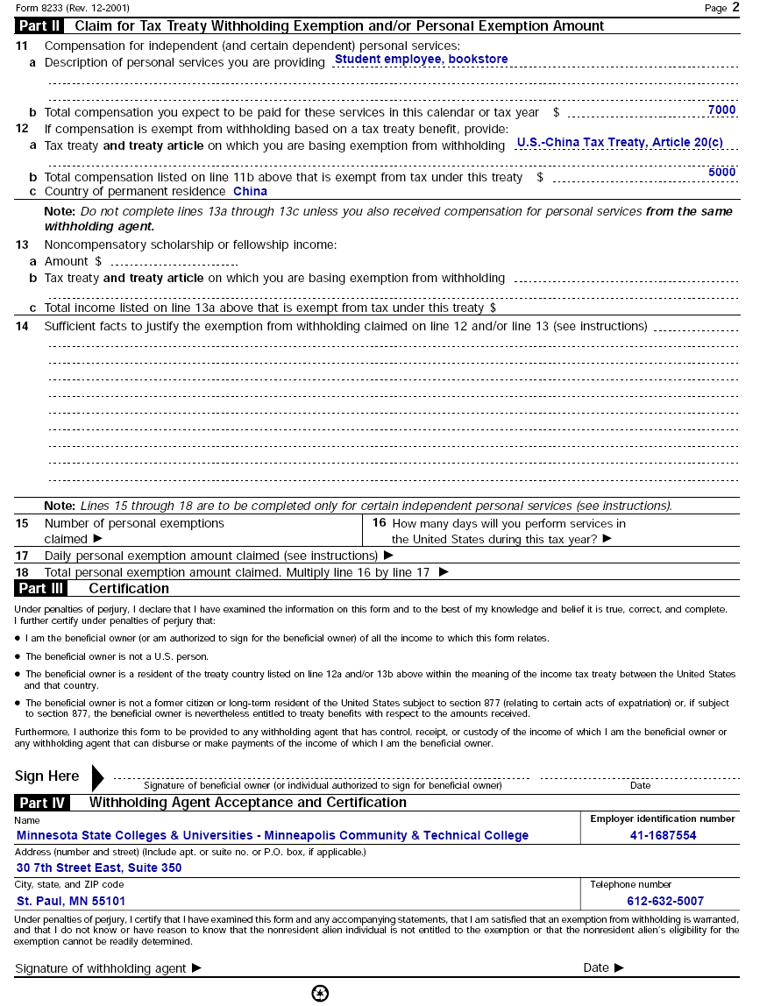
Must be mailed within
5 days from
the withholding agent
signature date
Tax Services Contact
12/18/2006

Slide 57
8233 Statement Attachment – J-1 Scholar
People’s Republic of China
I was a resident of the People’s Republic of China on the date of my arrival in the United States. I am not a U.S. citizen. I have not been lawfully accorded the privilege of residing permanently in the United States as an immigrant.
I have accepted an invitation by the U.S. government, or by a university or other recognized educational institution in the United States to come to the United States for the purpose of teaching or engaging in research at Minnesota State University, Mankato, which is an accredited educational institution or scientific research institution. I will receive compensation for my teaching, lecturing, or research activities.
The teaching, lecturing, or research compensation received during the entire tax year qualifies for exemption from withholding of federal income tax under the tax treaty between the United States and the People’s Republic of China. I have not previously claimed an income tax exemption under this treaty for income received as a teacher, lecturer, researcher, or student before the date of my arrival in the United States.
Any research I perform will be undertaken in the public interest and not primarily for the private benefit of a specific person or persons.
I arrived in the United States on 12/15/2006 [insert the date of your last arrival in the United States before beginning the teaching or research services for which the exemption is claimed]. The treaty exemption is available only for compensation received during a maximum aggregate period of three years.
Tax year treaty being claimed for 2007_;
Under penalties of perjury, I declare that I have prepared this form and to the best of my knowledge and belief, it is true, correct, and complete.
Signature of nonresident alien individual_ Mei Lee __________Date __12/16/2006_________

Slide 58
8233 Naming
Send 8233 separate from the TRIF packet
Naming Convention for 8233
  Campus ID
  Employee Last Name – first 4 letters plus Employee First Name – first two letters
  Last four digits of SSN
  Tax year
  8233
  EX: 0071.leeme.6789.2017.8233
Notes:
Send 8233 separate from the TRIF packet
Naming Convention for 8233
Campus ID
Employee Last Name – first 4 letters plus Employee First Name – first two letters
Last four digits of SSN
Tax year
8233
EX: 0071.leeme.6789.2017.8233 Chinese scholar example

Slide 59

Example: Taxing Mei Lee
NRA J-1 Scholar = Exempt from FICA Taxation
U.S. – China Tax Treaty Benefit
  Article 19 of US-China Tax Treaty
  3 Years, No income limit
  IRS Form 8233
  Year End Reporting IRS Form 1042-S
Notes:
Mei Lee is our J-1 visiting scholar from China who is teaching at MSU, Mankato
When she completed the TRIF we determined that she is a nonresident until 1/1/2019
As a nonresident alien present under J-1 status she is exempt from FICA taxation
She may claim a tax treaty benefit that exempts all her earnings from federal and state taxation by completing the 8233 and 8233 statement attachment
Is she claims the tax treaty benefit she will receive form 1042S reporting her wages instead of a w2

Slide 60
State Employee Summary
IF Employee I-9 = “an alien authorized to work until…”, THEN
Payroll Tax Residency Information Form must be completed & immigration documents copied
Tax Services determines residency & communicates appropriate tax treatment to Campus
Campus sets employee up in SEMA4 with correct tax treatment

Slide 61
Student Employee Summary
IF Employee I-9 = “an alien authorized to work until…”, THEN
Complete the Student Payroll Tax Residency Form
  Students must complete Sections A and D. If they have been in the U.S. prior to their current visit, they must also complete Section C.
  Student Payroll copies the student’s immigration documents & completes Sections E, F and G.
Keep the original form with the employee’s records
Send a copy of the completed form and related immigration documentation to Tax Services
Student Payroll enters the Tax Residency Year on ISRS Student Employee Setup (PR0021UG) Screen

Slide 62
Sending Information to Tax
Scan to PDF
Use MoveItSecurely to send the TRIF and 8233 packets
https://moveitsecurely.mnscu.edu
Use the address book within MoveItSecurely
14 day window for downloading Packages
Notes:
Please scan the tax residency form and immigration documents to PDF
Review to make sure that all documents are clearly legible
Use our web based secure file sharing app MoveItSecurely to send the information
The email addresses for all Minnesota State employees are loaded in MoveItSecurely
A notification is sent to the recipients email to let them know they have a “package”
Important to remember: You have a 14 day window to download the package before it disappears forever

Slide 63

Compliance =
Cooperation & Communication
Notes:
In order to comply with the tax law, we have to work together –
Tax in the system office must work with each college/university and on campus academic and administrative office must work together
(Photo by Tak Wong of the system office)

Slide 64

Tax Website – Nonresident Taxation
Notes:
What’s on the site
How to find the site

Slide 65
Questions?

