Slide 1
Strengthening Career and Technical Education for the 21st Cent
Strengthening
Career and Technical Education
for the 21st Century
September 2020
Perkins V
Notes:
Introductions…
Strengthening Career and Technical Education for the 21st Century is the latest amendment to Carl D. Perkins Career and Technical Education legislation. It is one of the fiscal resources that districts/colleges have available to support their career and technical education programs and services. Today we’ll do a very brief broad-stroke picture of CTE but our focus is on the specific federal grant affectionately known as Perkins V.

Slide 2
One Revenue Source: Federal Perkins Allocation
$1.2 Billion
Federal Allotment
$16.2Million
Local Consortia
$18.9 Million
Minnesota
Notes:
By formula (census and age of our population are major determinants) the federal government awards Minnesota its Perkins allocation.
Also by formula, Minnesota State awards local consortia their allocation.
Factors in the calculations at the local level include concentrators, Pell eligible, square mileage (rural) or high numbers as part of Reserve.
The full federal allocation to the state of Minnesota July 1, 2020 is $18.9 million. The state award is recalculated annually at the federal level.

Slide 3
Minnesota Overview
Vision
Advancing career and technical education empowers every learner to realize a rewarding career.
Mission
Quality career and technical education ensures every learner has equitable access to career-connected learning through a network of knowledgeable partners.
An equity lens for decision-making
Inclusion of all stakeholders
Being bold, innovative and focused on continuous improvement
Responsiveness to the evolving labor market
Principles
Notes:
Minnesota revised its Career and Technical Education vision , mission and principles as the Perkins V provided the opportunity to review our historical work and our future needs.
These statements are intended to support and influence our work throughout the 4-year Perkins V state plan.
The on-going strategic work for the state is being accomplished through five workgroups:
Advancing CTE- Providing avenues for increasing awareness and strategic communication of the value of CTE
Career-Connected Learning- Designing and supporting quality programs and programs of study that include authentic work experiences, leaderships, and connections to local industry needs.
Integrated Network- Activate a deliberate coalition charged to build, reinforce and maintain relationships of trust with other organizations to further support CTE goals as part of a workforce development system
Equity and Inclusion-Identify key issues that impact success of special populations and inequities in access and opportunities for these learners in CTE
Knowledgeable Experts- Provide professional development to our coordinators, our partners, our faculty and teachers to support student success

Slide 4
PERKINS V
Career Exploration Authentic Career Connected Learning for Students
Programs of Study
Workforce Development
Economic Vitality
Learner Success
Recruit, Retain, Support, Develop Educators
Notes:
The end user , the most important part of our work, is our student! While we do not directly teach/impact that individual, our programs and services certainly have impact. Are students successful? How do we define success? How do we know EVERY student has the opportunity for success? Have we examined both access/ recruitment and continued support to ensure student success?
Perkins is respectfully responsive to the need for economic vitality for the region, community, and the individual.
This work is very dependent upon having qualified educators whose profile resembles the students being served.
Therefore- we must recruit, retain and develop educators. We have to have quality, prepared educators to facilitate the success of every student.

Slide 5
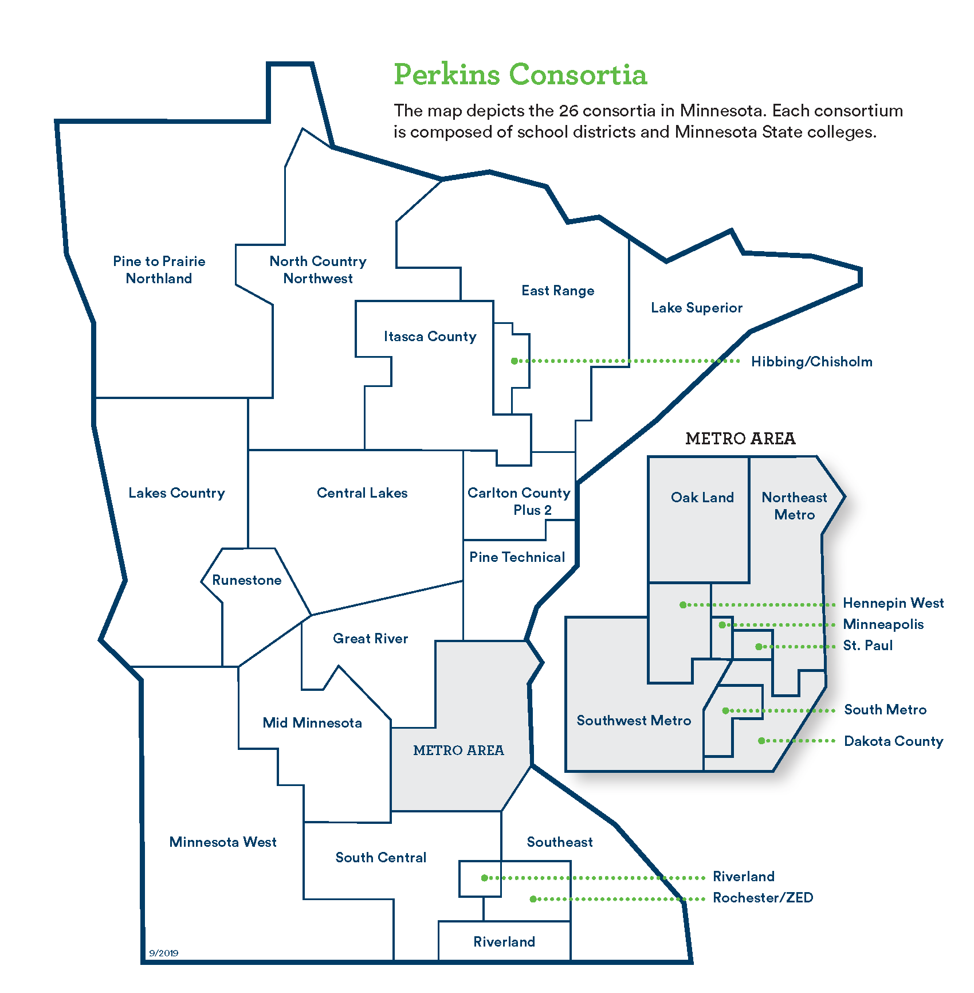
Perkins Context: Consortia
Notes:
Perkins work in Minnesota is conducted by the partnership of Minnesota State Colleges and Universities and Minnesota Department of Education through the distribution of funds to local consortia.
Local consortia must consist of at least one public school district and one 2-year Minnesota State college.
Minnesota has operated under a consortia model since the implementation of Perkins IV, 2006, which put ahead in terms of our Perkins V implementation.
Consortia determined their own “partners” which had to include at least one school district and one of our 2-year colleges. With the increased attention to size, scope, and quality, the consortia have been asked to review their governance structures. The map above shows the current consortia.
Average allocation: $615,000
Ranges from $200,000 to 1.7 million

Slide 6
Workflow
July 1
Allocation Award & Application Approval
June
Local Application Feedback
October 1
Due: Local Annual Performance Report
May 1
Due:
Local Application
November
Annual CTE Works!
Summit
April
Due:
State Plan
December 31
Due: State CAR
February
Reallocation Award
Notes:
Our workflow has some regular events that are reflected in the diagram above.
Our fiscal year begins July1 when local consortia schools receive their forward-funding of the Perkins allocation. This allocation is based on an approved local application.
October 1 the full local award is loaded for distribution.
The next formal interaction between the state and the occurs at the consortia submit their Annual Progress Reports (APR).
If consortia did not fully spend all of the prior year’s award, these dollars are collected and redistributed as close to the first of the year as we can manage.
May 1, in the odd years- updates or major changes to the application as well as a budget request are submitted. Every 2 years the CLNA will need to be completed and submitted with the local application.
Perkins work in Minnesota is conducted by the partnership of Minnesota State Colleges and Universities and Minnesota Department of Education through the distribution of funds to local consortia.
Local consortia must consist of at least one public school district and one 2-year Minnesota State college.

Slide 7
Funding
General operating funds = sustain and maintain
Leverage the Perkins funding to grow and innovate

Slide 8
Funding Decisions
Local Application
Community Needs
Local Capacity
Student Needs
It’s a process…
High-skill
High-wage
In-demand
Notes:
Student Needs: includes attention to special populations. What’s the current student profile? Is the CTE participation representative of the full student population?
Local Capacity: credentialed teachers, size, scope and quality of offerings, fiscal resources, physical resources, other projects and revenue sources at the local level.
What’s the community want or need is reflected by the CLNA: High-skill, high-wage, in-demand
All this research and data analysis becomes part of the local application. At the local level this influences your local uses of funds, your strategic planning, and your local programming and services.

Slide 9
State-level Performance Indicators
https://public.education.mn.gov/MDEAnalytics/DataSecure.jsp
Notes:
Individual district and consortium data files have been compiled.
Historical data can be accessed on MDE website under Data Center-Secure Reports –Carl Perkins Secure Reports
https://public.education.mn.gov/MDEAnalytics/DataSecure.jsp
This data is reflected in narrative #5 of your application.
The second data component reflects your examination of performance gaps (Local application narrative #8)

Slide 10
Local Decisions
Given your CLNA research, what are your local consortium’s primary goals for the next 2 years?
How will you support quality program/programs of study at the local level?
How do you provide equity of access and support for student success?
How will you make meaningful progress in meeting these goals?
With whom will you partner to make progress?

Slide 11
Local Opportunities

Slide 12
Local Stories

Slide 13
Questions? How can we help?

Slide 14
WIOA Partner Program
Note: Minnesota’s Perkins V plan is a partner program in the state’s WIOA combined plan. A Combined Plan outlines a four-year strategy for WIOA’s six core programs plus one or more of the Combined State Plan partner programs. Core programs include: Adult, Dislocated Worker, Youth, Wagner-Peyser Act, Adult Education and Family Literacy, and Vocational Rehabilitation. Minnesota partner programs include Perkins V, Minnesota Family Investment Program (MFIP), Supplemental Nutrition Assistance Program (SNAP), Trade Adjustment Act (TAA), Senior Community Service Employment Program (SCSEP), and Reintegration of Ex-Offenders Program (Second Chance Act).
Notes:
Just for reference

Slide 15
Perkins IV To Perkins V Changes
Attention to Size, Scope and Quality
Consortia level and program/services level
Requirement of Comprehensive Local Needs Assessment
Opportunity to review fiscal distribution
Use of funds
Includes recruitment, retention, training of educational professionals
Reserve: Innovation, Programs of Study
State Determined Performance Levels
Expansion of data requirement and performance for Special populations
Notes:
For historical reference:
What stayed constant from Perkins IV to Perkins V?
Purpose and Intent
FOCUS ON IMPROVEMENT AND INNOVATION; SUPPORT OF INSTITUTIONS AND PROGRAMS
New Purpose- Related to increasing employment opportunities for unemployed or underemployed.
Current structure and funding streams
Title 1- Basic State Grant
Funding formulas
Federal to state and state to local recipients
Who gets funding?
No change.
What changed?
The research done through the comprehensive needs assessment ties to the actions and to the budget.
POS alignment to the high-skill, high-wage, and in-demand occupations and emerging occupations of the local/regional community.
Increased attention to equity of access.
Attention to the critical need for teachers.

Slide 16
Jeralyn Jargo
State Director Career and Technical Education
Jeralyn.Jargo@minnstate.edu
www.minnstate.edu/system/cte/Strengthening-CTE

