Slide 1
Strengthening Career and Technical Education for the 21st Cent
Strengthening
Career and Technical Education
for the 21st Century
November 2019
Perkins V: Opportunities for Change
Notes:
Good Morning
Let us introduce ourselves……

Slide 2
Agenda
Perkins Leaders Annual Fall Meeting
8:00-8:30 a.m. Welcome and Introductions
8:30-9:15 a.m. All Things Data
9:15-10:00 a.m. Perkin V: 4-year Plan, Feedback, Timeline
10:00-10:30 a.m. Activity and Short Break
10:30-11:30 a.m. Completion of Morning Work
11:30-12:30 p.m. Lunch and Peer Packets
12:30-2:30 p.m. Cross-Consortium Work
2:30-2:45 p.m. Break
2:45-3:45 p.m. Panel: Comprehensive Local Needs Assessment
3:45-4:00 p.m. Conclusion of Day & Material Distribution
Notes:
When I say the phrase “career and technical education” what comes to mind? I am going to ask you to use ONE WORD to describe what comes to mind.
Pair- Share
Quickly report out.

Slide 3

“In every change, in every falling leaf there is some pain, some beauty. And that’s the way new leaves grow.”
~ Amit Ray
Notes:
Overview and a bit of history on MN’s organization-
We continue to work in consortia
We continue to work using the ‘wheel” as our framework
We continue to work with POS
Change from RPOS and POS-- State recognized POS.
We continue to stress making “meaningful progress” (continuous improvement) and supporting innovation.

Slide 4
Career Technical Education (CTE)
Career Technical Education (CTE)
provides learners of all ages with the academic and technical skills, knowledge and training necessary to succeed in future careers and to become lifelong learners.
In Minnesota Career Technical Education programs are a sequence of courses that provide students a pathway to postsecondary education and careers.

Slide 5
Minnesota Overview
Vision
Advancing career and technical education empowers every learner to realize a rewarding career.
Mission
Quality career and technical education ensures every learner has equitable access to career-connected learning through a network of knowledgeable partners.
An equity lens for decision-making
Inclusion of all stakeholders
Being bold, innovative and focused on continuous improvement
Responsiveness to the evolving labor market
Principles
Notes:
Many of you have heard ….Perkins…..
Reflect on the variety of words from the ice breaker.
At the state level- we also have a variety of “words” to explain our work.
Perkins IV used 5 goals to explain it.
As we moved to new legislation we brought a group together to help us redefine our work with the leverage of RESET provided by Perkins V.
This slide depicts our vision, mission, principles

Slide 6
Minnesota Leadership Model:
State to Local Consortia
Minnesota State
MN Department of Education
Local Perkins Consortia
Secondary + Postsecondary
Notes:
Governance at the State Level
How MN has chosen to implement the career and technical education support of the federal government (Perkins)
---------
The secret sauce of Perkins success in Minnesota is the interdependence of Minnesota State, Minnesota Department of Education and the local Perkins consortia in executing the grant and leveraging the resource to impact all of career and technical education in Minnesota.
A cooperative agreement between the Commissioner of Education and Minnesota State Colleges and Universities will annually provide for the distribution of federal funds between secondary and postsecondary career and technical programs. Distribution to local education agencies must be determined by state and federal law. ~ Minnesota Rule 3505.1700 *Dependency on Approved State Plan
~ Minnesota Rule 3505.1700
*Dependency on Approved State Plan

Slide 7
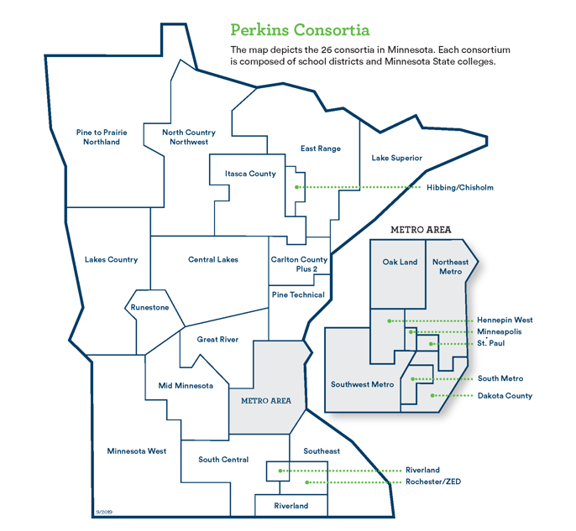
Minnesota Leadership Model:
State to Local Consortia
Notes:
Each consortium has a minimum of one college and one school district.
We do have one consortium with 43 school districts.
You can see the organization is geographical. The consortia structure joins our more than343 high schools with the 31 colleges.
Metro “call Out’ maps #17 and #18 above represent our consortia with One College + One District
Minnesota West represents the multiple campuses and multiple districts– 5 campuses/one accredited college and 43 districts

Slide 8
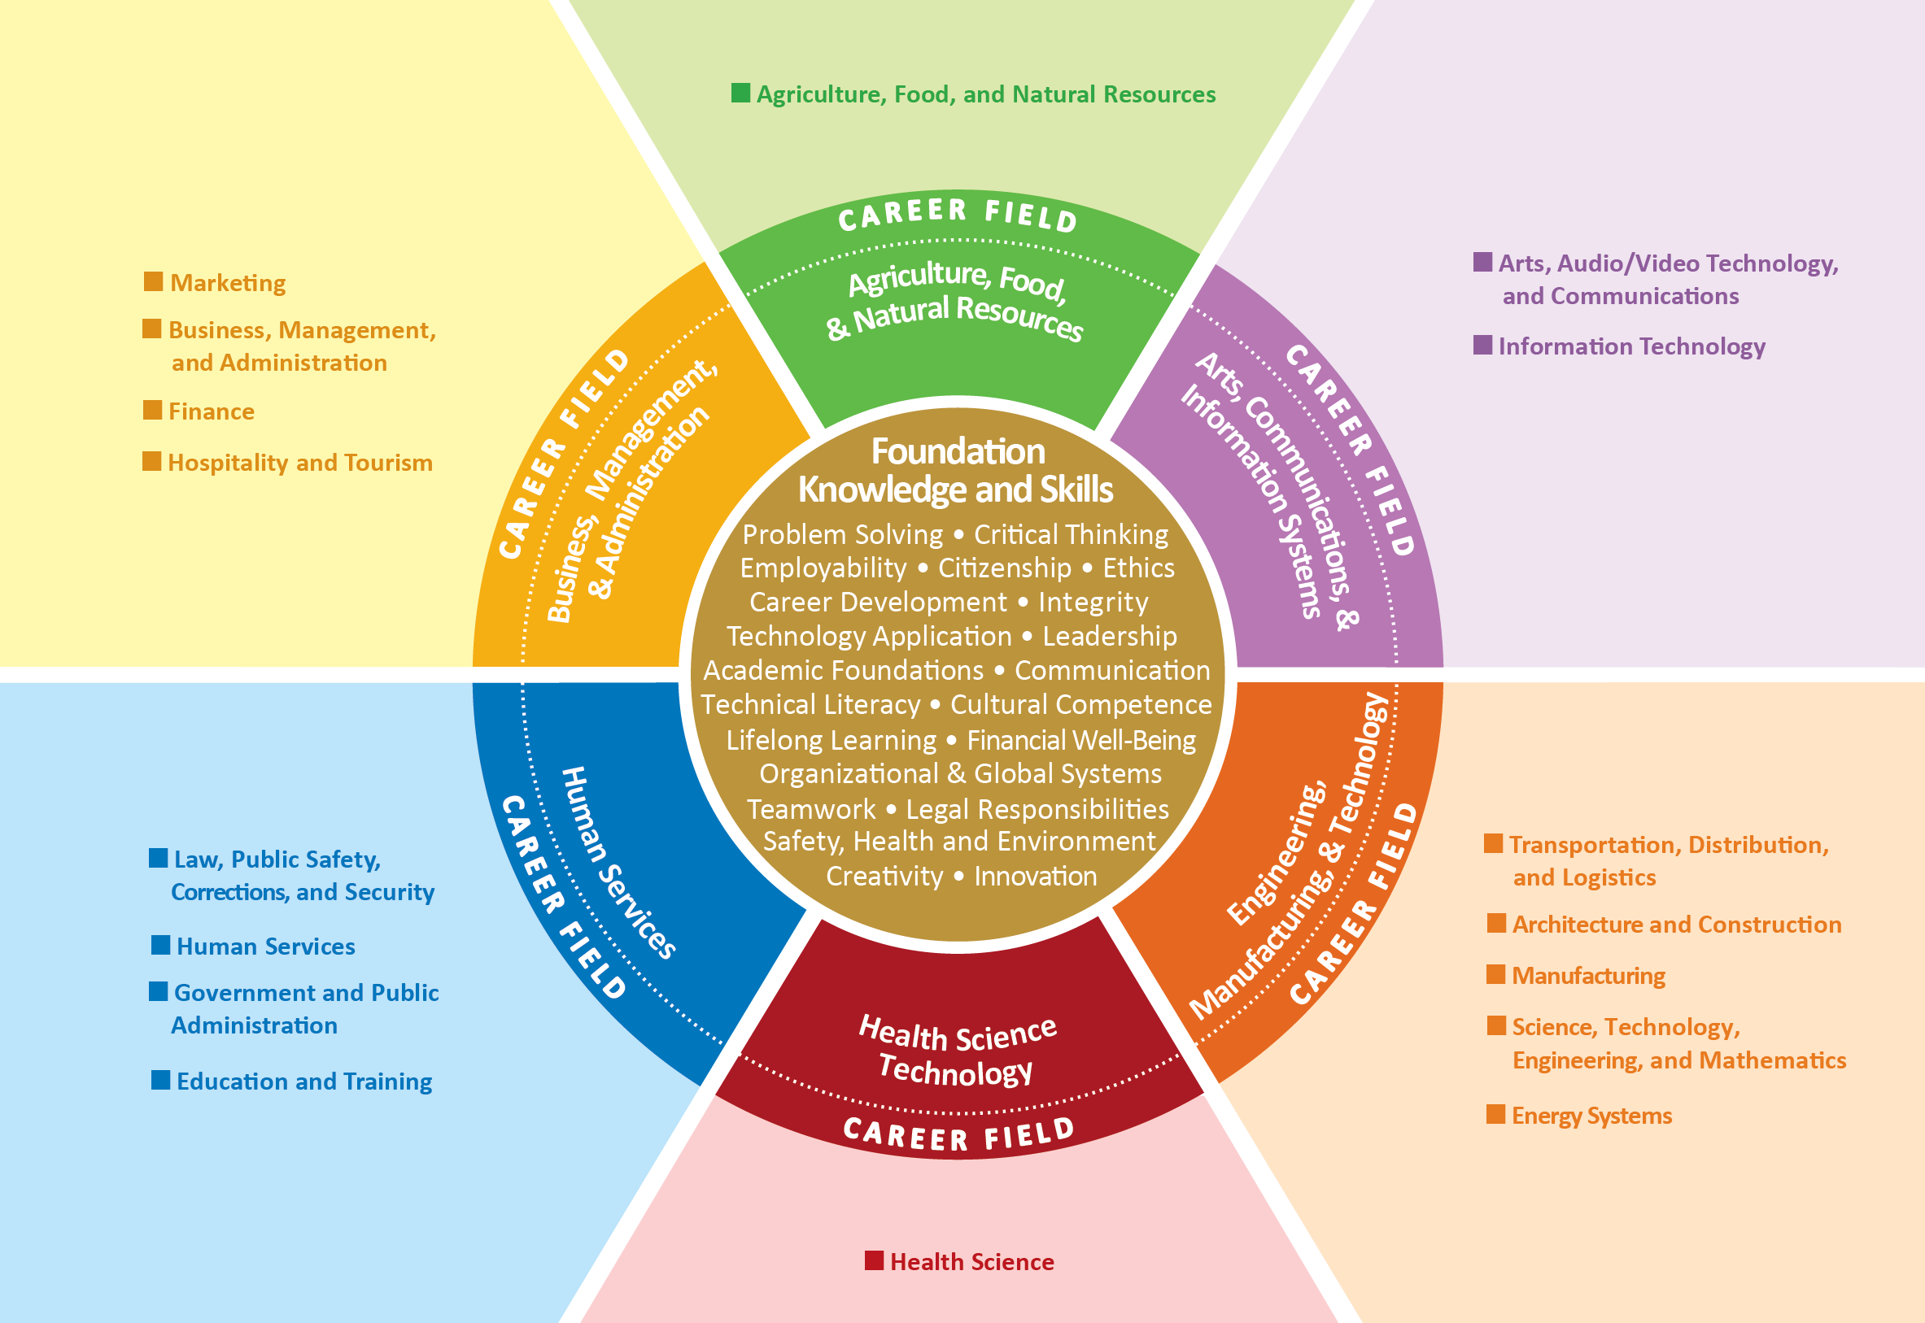
Minnesota Career Fields and Clusters
Notes:
Our work has been (and continues to be ) organized around national research that sorted careers into 6 fields.
……..explain the wheel.

Slide 9
State Recognized Programs of Study
7 Elements of Minimum Requirements
Course standards accurately align to the academic, technical, and employability skills
Active involvement from an integrated network of partners
Secondary program(s) meets MDE program approval requirements
Postsecondary academic program meets Minnesota State board policy
Materials, Equipment and Resources
Authentic work experiences at the secondary and/or postsecondary level
Development, improvement, and advocacy are supported by findings from a comprehensive local needs assessment
Notes:
The wheel depicts career fields and clusters.
Each cluster also has multiple programs of study.
Perkins V defines Program of Study as a coordinated, non-duplicative sequence of academic and technical content at the secondary and postsecondary level that incorporates challenging state academic standards, that includes both academic and technical knowledge and skills that are aligned with state-approved frameworks, including employability skills, that is aligned with local and regional needs, progresses in specificity (beginning with all aspects of an industry or career cluster) and leading to more occupation-specific instruction, has multiple entry and exit points that incorporates credentialing, and culminates in the attainment of a recognized postsecondary credential. (Strengthening Career and Technical Education for the 21st Century Act, 2018)
In order for a POS to become State Recognized all of the Minimum Requirements must be met. (See the Rubric/Checklist)
Process:
Consortia will submit the 6 Minimum Requirement Rubrics with their local application.
Consortium are able to make changes and submittals to their State Recognized Programs of Study any time throughout the application cycle.
Currently, the consortia can email the Career Pathway Director for submittal and approval to the master list (in the future, this process may be completed using the formal application software).

Slide 10
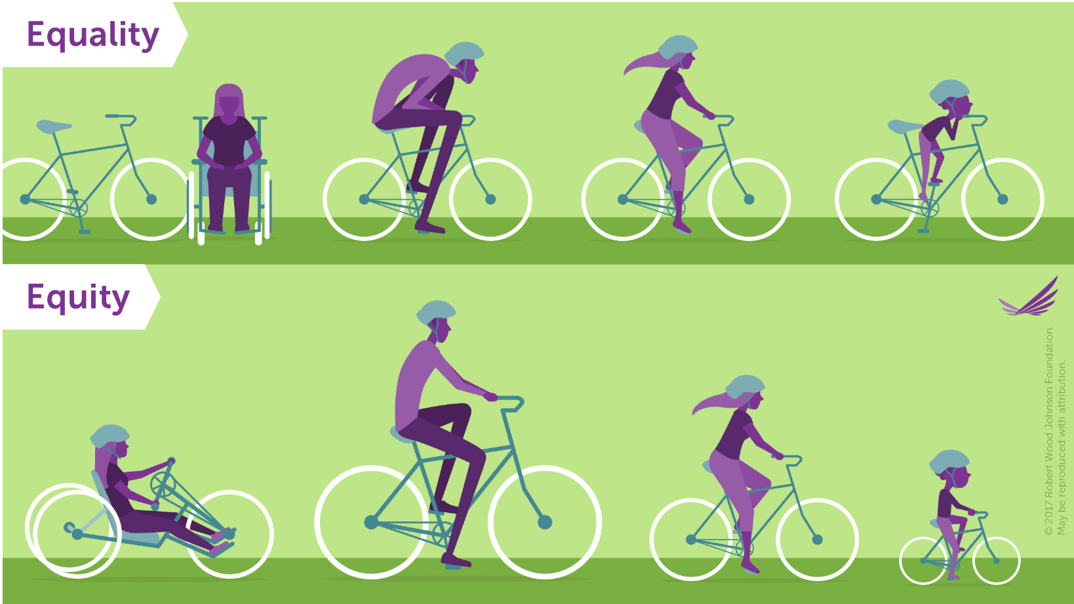
Equity of Access
Notes:
Enhanced, elevated priorities of Access and equity.
Service to special population has expanded groups.
Note: Changes to Special Populations
Individuals with disabilities
Economically disadvantaged
Individual preparing for non-traditional fields
Single parents
Out-of-workforce individuals
English learners
new
Homeless individuals
Youth who are in or have aged out of foster care
Youth with a parent who is an active duty parent

Slide 11
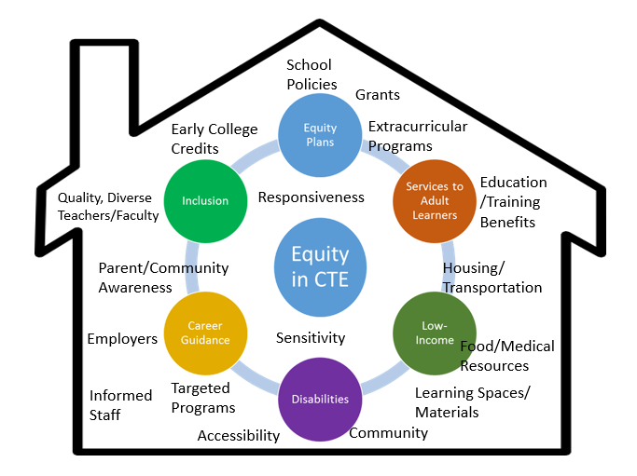
Equity and Inclusion Requires Partnerships
Notes:
Continuing to be a high priority of Perkins work is equity and inclusion.
This applies to the student we recruit and retain as well as our professionals- teacher, faculty, etc.
Equity of access also applies to the opportunities ALL students can access.
It requires awareness, partnerships, knowledge and communication of support services and groups----- It Takes A Village!

Slide 12
Federal to State to Local Relationships
$1.193 Billion
$16 million Local Consortia
85%
Federal Allotment
$18.7 Million
Minnesota
Notes:
some things stay the same; many things change.
Differentiate the Perkins V language in the law and the required appropriation bill that actually provides the dollars.
Federal Level to State to Local
Of the local funds: 85 % of the 16 million is held for distribution at the local level.
In the past both the basic and reserve components have been distributed through specific formulas.
As we RESET with Perkins V we are proposing a change in that distribution model.

Slide 13
Fiscal Considerations: Consortium funding
Basic Funds: Implementation of the approved application as submitted by the full consortium
Reserve Funds: Rural, areas with high numbers of CTE students. Must be targeted specifically for fostering innovation or for programs of study aligned with high-skill, high-wage, or in-demand occupations or industries.
“Each eligible recipient that receives funds under this part shall use such funds to develop, coordinate, implement, or improve CTE programs to meet the needs identified in the comprehensive needs assessment…”
Notes:
New ideas:
Change of move 5% more of the 85 % local dollars so the basic funds and formula would now be 80%
Changing the reserve allocation to 5% (down from 10%) and awarding it through an RFP process.
The reserve now has specific targets and to be innovative. An RFP process provides the opportunity for collaboration and potentially a large sum of dollars for innovation.
It provides a focus to these dollars that may have been absent in the past.

Slide 14
Fiscal Considerations: Local Use of Funds
Necessary
Reasonable
Allocable
Based on the Comprehensive Local Needs Assessment
Supports the system/program/service
  Not an individual benefit
Referenced in the application
Does not supplant
If not allowable under Perkins IV assume not allowable under Perkin V.
    Exception- middle grades participation in career exploration
Notes:
Federal funding-- Necessary, Reasonable, Allocable

Slide 15
CLNA Must Address…..
Student performance on federal accountability indicators, disaggregated
How programs are aligned to labor market needs
Whether programs are of sufficient size, scope and quality to meet all students’ needs
Progress toward implementing programs and programs of study
Efforts to improve recruitment, retention and training of faculty and staff
Progress toward improving access and equity
Notes:
Student performance
Alignment to labor market needs
Sufficient size, scope and quality
Program toward POS
Recruitment, retention and training of faculty /staff
Improving equity of access

Slide 16
Implementation
Relationships
Informs
Needs Assessment
Identify areas of strength in CTE system/programs
Identify areas of weakness and gaps in CTE system/programs
Informed/validated by stakeholders and partners
Look for innovation
Local Application
Lay out eligible recipient’s vision/theory of action for CTE
Identify strategies, solutions and investments to sustain and scale strengths in CTE system/programs
Identify strategies, solutions and investments to address weaknesses and gaps in CTE system/programs.
Supports innovation
Informs
Informs
Notes:
Timelines- consortia work through CLNA for inclusion in the application submitted May 1, 2020.
The CLNA will need to be repeated, at a minimum, every two years.
The application submitted will apply to July 1, 2020 through June 30, 2022.
However, an annual budget and any updates will need to be submitted May 1, 2021.

Slide 17
Dependencies
Comprehensive Local Needs Assessment
Actions to Address:
Programs of Study: High-skill; high-wage; in-demand
Student Performance; access and equity
Teacher recruitment
Professional Development
Budget
Notes:
The driver is your CLNA.
That informs your actions.
Your budget is built to support your actions.

Slide 18

Engage
With Perkins IV, we always………..
Notes:
Habits of Perkins IV
Complete this sentence,
Perkins IV, we always….
Model from the state staff…
Always monitor 4-6 consortia every year
Always work with 26 consortia
Always have one state-wide professional development event
Always confuse you……
Always have taco bar at CTE Works!
Write a Perkins IV habit on the blue paper at your table.
Gather…. Tear up!
Build new….
Go to break and number off.
Perkins V, build new.

Slide 19
Be Bold
Fresh Eyes
Common Sense
Adaptations
Change in “habit”
Not everything is an apple watch
Must be implemented
CLNA information and analysis
Notes:
Big Picture Innovations.

Slide 20

Falling leaves from the tree,
Falling star from the sky,
Flowers leaving its fragrance, souls getting apart,
I found out,
NOTHING IS PERMANENT!
~Piyushkuhad
Notes:
Nothing is Permanent.
Perkins language is an example!
We are going to transition to asking you to give us some feedback on change.
Why do we need to talk about change?

Slide 21
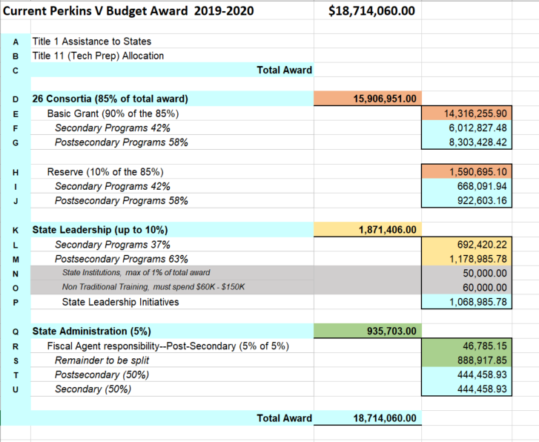
Current Perkins V Award
2019-2020
Notes:
Allocation percent and structure awarded July 1, 2019.
Some lines are federally set:
D- cannot be less than 85%
H- Reserve in the past was up to 10%
K- Cannot be more than 10%
N, O- minimums set by feds. MN takes this out of postsecondary leadership funds.
Q- cannot exceed 5% just as the consortium are allowed.

Slide 22
Federal FY2019 Allocation: $18,714.060.00
Notes:
Potential in changes to reserve in the 4-year plan beginning July 1, 2020.
The total funding into the state Federal FY2019 was $18.7 million.
The distribution is largely driven by the federal requirements:
85% goes to LEAS. Local Education Agencies
Current
Basic = 90% of 85% of total
Reserve = 10 % of the 85% of total
Distribution of both by formula
50% Rural: 50% High numbers
B) Basic = 95% of 85% of total
Reserve = 5 % of the 85% of total
Distribution by formula for basic
Distribution of reserve by RFP
C)Basic = 85% of 85% of total
Reserve = 15 % of the 85% of total
Distribution of both by formula
50% Rural: 50% High numbers
Monitored: AmpliFund
Perkins V Opportunities

Slide 23
Fiscal Considerations: Local Use of Reserve Funds
  Section 135
  1) in--
  Rural areas;
  Areas with high percentages of CTE concentrators or CTE participants
  Areas with high numbers of CTE concentrators or CTE participants
  Areas with disparities or gaps in performance
  2) In order to—
  foster innovation through the identification and promotion of promising and proven career and technical education programs, practices, and strategies, which may include programs, practices, and strategies that prepare individuals for nontraditional fields; or
  B. Promote the development, implementation, and adoptions of POS or career pathways aligned with State-identified high-skill, high-wage, or in-demand occupations or industries
Notes:
Perkins V- quote

Slide 24
5 Whys
Better service to our learners
Creative access to larger dollar amounts to be innovative or impact change
Concern that the small dollar amounts just hold off any effort to Be Bold
Fiscal changes may promote changes of habit in management of projects/services/personnel
Allow larger collaborations to serve students

Slide 25
5 Whys
Anything that’s not per allocation formula and “draws” creates business process challenges
Perception that metro always gets the better deal if RFP process is in place
Capacity to focus on other projects not there
Larger consortia may just have the resources to apply for and implement an RFP that smaller consortia would not have
“We use our money very efficiently; don’t muck it up.”

Slide 26
Input on Change
Fiscal Changes to Reserve Funding
% of reserve
Options range from 0% to 15%
Remember parameters on usage
Distribution of reserve
Formula distribution
RFP
Note: Changes to Reserve Cause Change to Basic
The total still must be 85%.
Discussion: Recommendation: Rationale
Notes:
Discussion at the table:

Slide 27
Input on Change
States have the ability, with public input, to alter the basic and reserve split
  42% secondary: 58% postsecondary
Discussion: Recommendation: Rationale
Notes:
Review, table discussion and recommendations.

Slide 28
Agenda
Perkins Leaders Annual Fall Meeting
11:30-12:30 p.m. Lunch and Peer Packets
12:30-2:30 p.m. Cross-Consortium Work
2:30-2:45 p.m. Break
2:45-3:45 p.m. Panel: Comprehensive Local Needs Assessment
3:45-4:00 p.m. Conclusion of Day & Material Distribution
Notes:
Quick look at our afternoon and expectations.

Slide 29
Lunch Activities
Consortia have been grouped for the afternoon activity. The color on your name tag indicates your group.
Enjoy lunch with your group AND…
You will need to share/review materials at lunch.
Color | Room Assignment
Blue | Minnesota Ballroom
Green | Arbor Lakes Room
Yellow | Lake Erie
Red | Lake Huron
Black | Lake Michigan
Notes:
At 12:30, please be in your assigned room.
Please, also, make sure you have read the cross-consortium materials from the other consortia in your group.
Each group has assigned facilitators.
Listen, talk, learn from each other. No judgement--- try replacing judgement with curiosity (wonder)

Slide 30

CLNA Panel
Where are you in the CLNA process?
Brian Cashman, Southeast
Jeannie Meidlinger, South Central
Eric VanBrocklin, Dakota County
Mary Ward , Central Lakes
Notes:
Reflecting on your own consortium--
Where are you in the CLNA process? (There are no wrong answers).
What challenges or roadblocks have you run into?
What’s been your experience getting others to participate?
Are you learning anything surprising about your consortium, your region, your area of the state? If yes, what’s the revelation?
Thinking about the elements of the CLNA:
Element #1: Student Performance on Required Performance Indicators
Element #2: Program Size, Scope, and Quality to meet the needs of all Students
Element #3: Progress towards Implementation of CTE Programs of Study
Element #4: Improving recruitment, retention, and training of CTE professionals, including underrepresented groups
Element #5: Progress towards equal access to CTE programs for all students
Which element has been the easiest to assess?
Which one the most difficult?
What advice would you offer to the group?

Slide 31
July 2019 Receipt of State Allocation and Distribution to Local Consortia
Jan 2020
Board of Trustees; MDE
Final Edits
February 2020
Plan to Governor’s Office (30 Day Review)
Review at Federal Level
July 2020 Receipt of State Allocation and Distribution to Local Consortia
Perkins V Timeline State
March 2, 2020
Submission of 4-year Plan to Federal DOE
Nov. Final Draft to Leadership
(30 day Public Comment)
Consultations
Aug, Sept, Oct Performance Indicator (60 day)
Sept. 11
GWDB
Community Consultations October - November
Notes:
In review- here’s a Visual of timeline for transition plan so you can look ahead.
BOT = Minnesota State Board of Trustees
MDE = Minnesota Department of Education

Slide 32
July 2019 Allocation Distribution to Local Consortia
Nov 4-6 Leadership Meeting and CTE Works! Review of 4-year State Plan
May 1, 2020 2-Year Local app due
10 questions + CLNA
July 2020
Distribution of Local Allocation
Development of Local 2-year Application
Perkins V Timeline Local
Oct 15 APR Due (Perkins IV)
Consultations
Aug, Sept, Oct Performance Indicator (60 day)
Aug-Feb CLNA
Notes:
In review- here’s a Visual of timeline for transition plan so you can look ahead.
BOT = Minnesota State Board of Trustees
MDE = Minnesota Department of Education

Slide 33
Accountability:
If Perkins V funds are successfully invested throughout Minnesota,
What will we see in our workplaces as a result?
What will we hear from employers?
What will secondary and postsecondary educators notice?
What challenges will be resolved or lessened?

Slide 34

Thank you
Jeralyn Jargo
State Director
Career and Technical Education
Minnesota State
Jeralyn.Jargo@minnstate.edu
(651) 201-1650
Michelle Kamenov
Career and College Success Division
Minnesota Department of Education
Michelle.kamenov@state.mn.us
(651) 582-8434
Thank You
Comments can also be submitted online at minnstate.edu/CTEHearing

Slide 35
NOTE
You can find this slide posted on the Minnesota State Career and Technical Education website under Consortium Resources.
www.minnstate.edu/system/cte/consortium_resources

