Slide 2
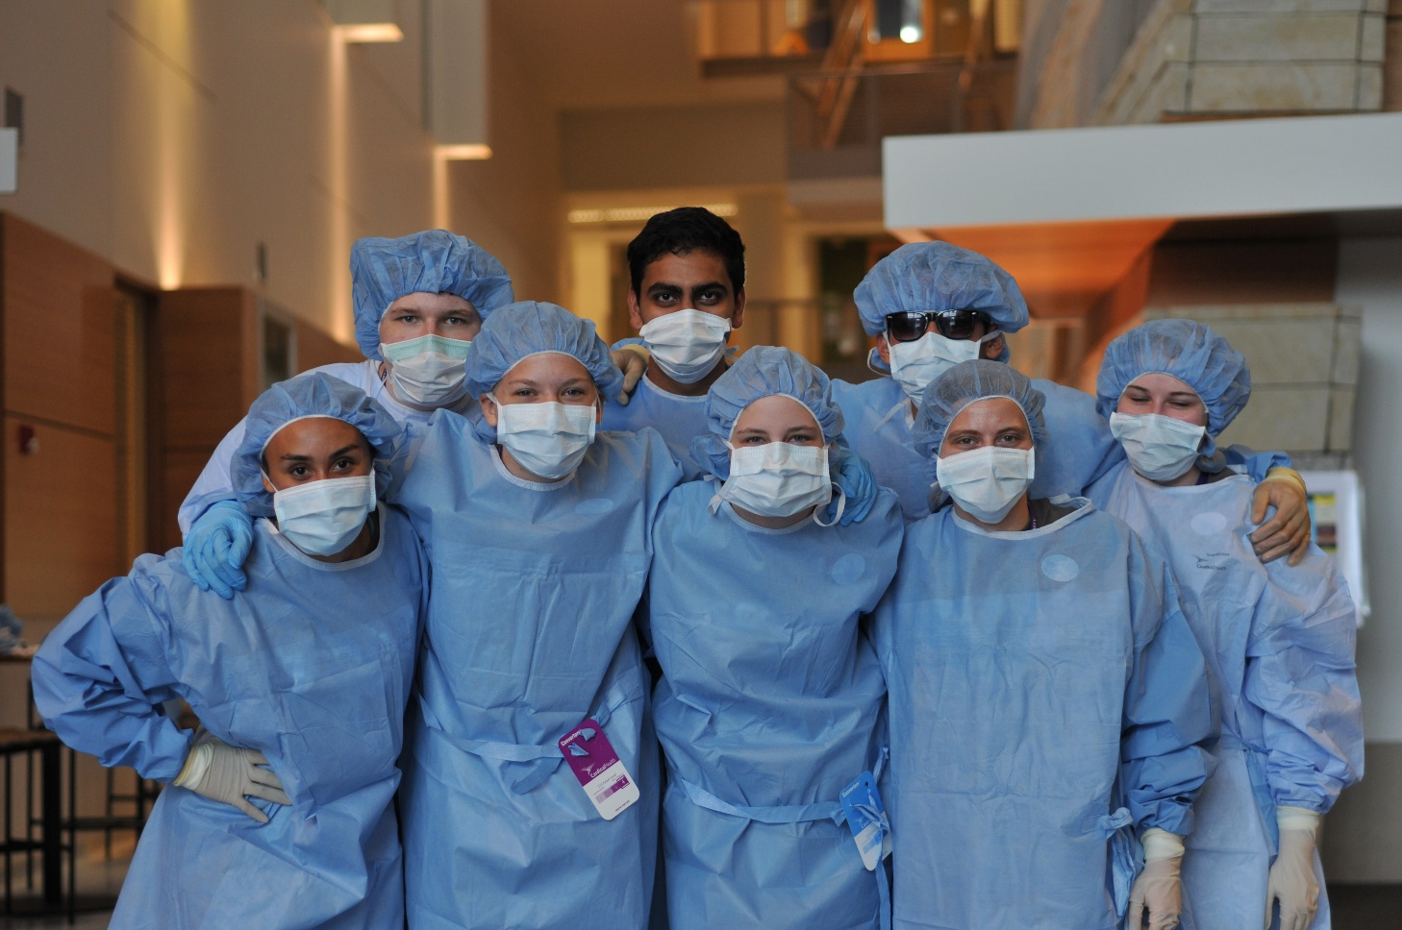
Co-Curricular
Scrubs Camps
HOSA Future Health Professionals
Notes:
It is almost impossible for me to talk about HealthForce without talking about partnerships. Over the past year, we have been involved in workforce committees or councils at Leading Age, Care Providers, and the MN Home Care Association. Other committee-like work has included the MN PIPELINE project, NGA Policy Institutes, and regional workforce councils.
This past year has been exciting as we’ve partnered with the MN State Energy Center of Excellence to implement a MN Legacy initiative. The Legacy initiative has brought us together with St Paul and Minneapolis Public Schools, Xcel Energy, healthcare employers, and many social service supports agencies to create a comprehensive and focused community around high school students whose families are living under the poverty threshold. I’m also happy to say that we have hired a Legacy student from the first cohort that graduated from Harding High School last year. James is currently enrolled at WSU and will be a Scrubs Camp counselor this summer.

Slide 3
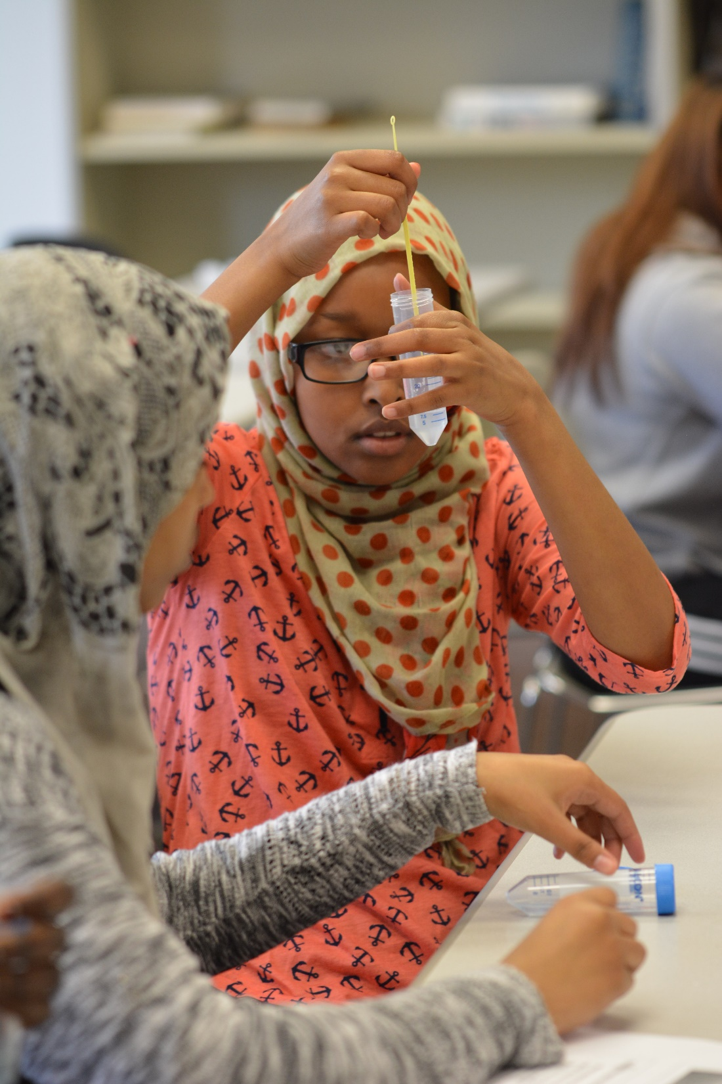
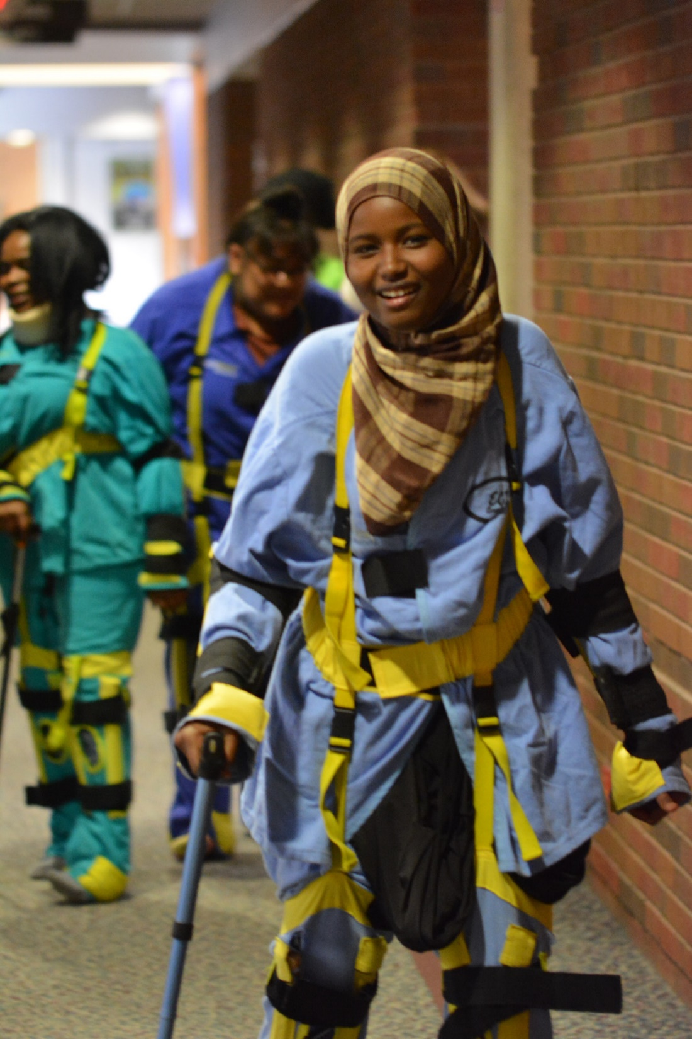
Health Science Curriculum
Health Care Core Curriculum
MN Nursing Assistant Online
Program Framework
Notes:
Speaking of Scrubs Camps, the photos I’ve been using have all come from a variety of our Scrubs Camp experiences. In 2016, 15 camps were offered in partnership with local planning committees. As an example of a great partnership, HFMN works with the Girl Scouts of the River Valleys to offer a day-long Scrubs Camp for girls in their Girls ConnectZ program. On May 17 & 18, over 300 girls attended health career sessions at Century College, Saint Paul College, and RCTC/WSU-Rochester. Today there are 44 middle schoolers at Scrubs Camp in Rochester. I am also glad to say that I have hired 2 Scrubs Camp alumns to serve as Camp Counselors. Each of them told me about the strong impact Scrubs Camp had on their choices of attending college and pursuing a healthcare path.
One of our more formal partnerships is The Clinical Coordination Partnership – TCCP. TCCP continues to revolutionize the way pre-licensure nursing clinical experiences are scheduled and supported. Over the past year, TCCP has been working with the University of Montana, and has been piloting a new product to make managing background checks, immunizations, and other requirements easier for nursing programs and clinical sites.
One area of work that has grown dramatically over the past year is the Minnesota Simulation in Healthcare Education Partnerships group. Led by an advisory council, this group of over 200 educators and providers comes together to share simulation resources and to advance the use of simulation to improve education and practice.

Slide 4
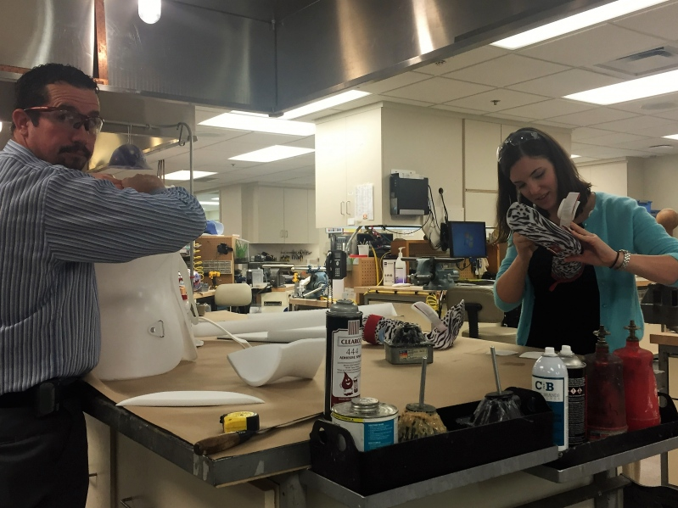
Professional Development
HCCC Educate the Educator
Online Course Tech Support
Health Science Educators Network
Teacher Training Webinars
Notes:
Speaking of Scrubs Camps, the photos I’ve been using have all come from a variety of our Scrubs Camp experiences. In 2016, 15 camps were offered in partnership with local planning committees. As an example of a great partnership, HFMN works with the Girl Scouts of the River Valleys to offer a day-long Scrubs Camp for girls in their Girls ConnectZ program. On May 17 & 18, over 300 girls attended health career sessions at Century College, Saint Paul College, and RCTC/WSU-Rochester. Today there are 44 middle schoolers at Scrubs Camp in Rochester. I am also glad to say that I have hired 2 Scrubs Camp alumns to serve as Camp Counselors. Each of them told me about the strong impact Scrubs Camp had on their choices of attending college and pursuing a healthcare path.
One of our more formal partnerships is The Clinical Coordination Partnership – TCCP. TCCP continues to revolutionize the way pre-licensure nursing clinical experiences are scheduled and supported. Over the past year, TCCP has been working with the University of Montana, and has been piloting a new product to make managing background checks, immunizations, and other requirements easier for nursing programs and clinical sites.
One area of work that has grown dramatically over the past year is the Minnesota Simulation in Healthcare Education Partnerships group. Led by an advisory council, this group of over 200 educators and providers comes together to share simulation resources and to advance the use of simulation to improve education and practice.

Slide 5
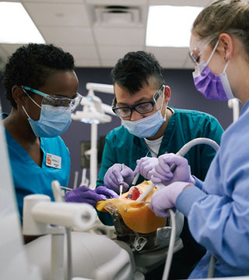
Partnerships
Educators
Employers
Agencies
Notes:
Speaking of Scrubs Camps, the photos I’ve been using have all come from a variety of our Scrubs Camp experiences. In 2016, 15 camps were offered in partnership with local planning committees. As an example of a great partnership, HFMN works with the Girl Scouts of the River Valleys to offer a day-long Scrubs Camp for girls in their Girls ConnectZ program. On May 17 & 18, over 300 girls attended health career sessions at Century College, Saint Paul College, and RCTC/WSU-Rochester. Today there are 44 middle schoolers at Scrubs Camp in Rochester. I am also glad to say that I have hired 2 Scrubs Camp alumns to serve as Camp Counselors. Each of them told me about the strong impact Scrubs Camp had on their choices of attending college and pursuing a healthcare path.
One of our more formal partnerships is The Clinical Coordination Partnership – TCCP. TCCP continues to revolutionize the way pre-licensure nursing clinical experiences are scheduled and supported. Over the past year, TCCP has been working with the University of Montana, and has been piloting a new product to make managing background checks, immunizations, and other requirements easier for nursing programs and clinical sites.
One area of work that has grown dramatically over the past year is the Minnesota Simulation in Healthcare Education Partnerships group. Led by an advisory council, this group of over 200 educators and providers comes together to share simulation resources and to advance the use of simulation to improve education and practice.

