Slide 1
Fiscal Year 2025 Operating Budget (Second Reading)
Finance and Facilities Committee
June 18, 2024
MinnState.edu

Slide 2
Board Policy 5.9 State Budget Requests & Annual Operating Budget Planning & Approval Timeline
May 20 – Legislative session ends
May 22 – Board of Trustees FY2025 operating budget first reading
June 17-18 – Board of Trustees FY2025 operating budget second reading and approval
July 1 – Start of FY2025
Summer/fall – Development of FY2026-2027 biennial budget request
October 2024 – Biennial budget request first reading
November 2024 – Biennial budget request second reading and approval
Late November 2024 – Submit biennial budget request to Minnesota Management and Budget

Slide 3
Board Motion June
“The Finance and Facilities Committee recommends that the Board of Trustees adopt the following motion:
Adopt the annual total all funds operating budget for fiscal year 2025 as shown in Table 5.
Approve the proposed tuition structure recommendations and differential tuition rationale for fiscal year 2025 as detailed in Attachments 1A through 1H.
Tuition rates are effective summer term or fall term 2025 at the discretion of the president. The chancellor or designee is authorized to approve any required technical adjustments and is requested to incorporate any approvals at the time fiscal year 2025 tuition recommendations are presented to the Board of Trustees.
Continue the policy of market-driven tuition for closed enrollment courses, customized training, and non-credit instruction, continuing education, and contract postsecondary enrollment option programs.
Approve the Revenue Fund and related fiscal year 2025 fees for room and board, student union, wellness and recreation facilities, and parking ramps/surface lots as detailed in Attachments 2A through 2E, including any housing fees that the campuses may charge for occupancy outside the academic year.
Authorize the chancellor or designee to enter into an agreement with the Learning Network of Minnesota to provide the funding appropriated to the organization in Minnesota Laws 2023, Chapter 41, Article 1, Section 3, Subdivision 4, in the amount of $4,115,000.”

Slide 4
Proposed Fiscal Year 2025 All Funds Budget
$s in millions | FY2024 Current Budget | FY2025 Proposed Budget | $ Change | % Change
Revenues
General Fund | $1,848.5 | $1,826.4 | ($22.1) | -1.2%
Revenue Fund | $104.4 | $118.7 | $14.3 | 13.7%
Other Funds | $386.0 | $409.6 | $23.6 | 6.1%
HEERF Funds | $6.4 | $0.0 | ($6.4) | -100.0%
Revenues Total | $2,345.4 | $2,354.6 | $9.4 | 0.4%
Expenses
Compensation | $1,436.2 | $1,491.7 | $55.5 | 3.9%
Operating costs | $904.7 | $911.5 | $6.7 | 0.7%
Expenses Total | $2,341.0 | $2,403.2 | $62.2 | 2.7%
Budget gap | $4.4 | ($48.4)
Fund balance to balance budget | $28.1 | $52.1
Budget balance | $32.5 | $3.7
Numbers may not add due to rounding

Slide 5
Proposed Fiscal Year 2025 General Fund Budget
$s in millions |  | FY2024 Current Budget | FY2025 Proposed Budget | $ Change | % Change
Revenues
 | State appropriation | $948.9 | $923.2 | ($25.7) | -2.7%
 | Tuition | $722.1 | $729.5 | $7.4 | 1.0%
 | Other revenues | $150.6 | $153.4 | $2.8 | 1.9%
 | Fund balance for 1x investments | $26.9 | $20.2
Total budgeted revenues |  | $1,848.5 | $1,826.4 | ($22.1) | -1.2%
Expenses
 | Compensation | $1,323.3 | $1,371.5 | $48.3 | 3.6%
 | Operating costs | $511.7 | $499.2 | ($12.5) | -2.4%
Total budgeted expenses |  | $1,834.9 | $1,870.7 | $35.8 | 1.9%
Budget gap |  | $13.6 | ($44.3)
Fund balance to balance budget |  | $16.2 | $45.9
Budget Balance |  | $29.8 | $1.6
Numbers may not add due to rounding

Slide 6
Minnesota State New Annual Operating Support in Current Biennium
Appropriations in Thousands of Dollars | FY2024 | FY2025 | FY2026
System Stabilization | $ 64,000 | $ 64,000 | $ 41,500
One-time Operation Support | $ 50,000
Tuition Freeze | $ 25,000 | $50,000 | $37,500

Slide 7
Enrollment Projected to Improve

Slide 8
Budget Development
Most colleges & universities held back FY2024 stabilization and/or operating support to offset less support in FY2025 to cover new inflationary costs.
Continued investments being made in biennial system priorities such as student success and equity and workforce and economic development.
The HCM and FIN Workday implementation and sustainment requires additional investments at the system-level.

Slide 9
Student Consultation
Board approved in April amendments to Policy 5.9 State Budget Requests and Annual Operating Budget Planning and Approval
Requirements for student consultation emphasized:
Alignment with Board Policy 2.3 and System Procedure 2.3.2 Student Involvement in Decision-Making
Consultation process
Position letter from campus student association
53 student consultation letters received
An overall theme was that student consultation was a collegial process with sufficient information provided to students on budget planning and rate setting
Each college and university student government communicates their description of the annual budget consultation based on their local processes

Slide 10
College, University, and System Reserves
College and university reserves
All but two colleges and universities are within the 5% to 7% Board required reserve
FY2024 system reserves - $13.25 million
$4 million loan to system office to pay up-front costs of redesigning office space at Wells Fargo
$2 million loan to St. Cloud State University to designate as an operating reserve
$2 million loan to Bemidji State University to help address university’s FY2025 cash flow challenges
FY2025 estimated system reserves - $5.75 million

Slide 11
Fiscal Year 2025 Tuition and Fees
Undergraduate tuition continues to be frown in FY2025
Average full-time college student saving $191 per year
Average full-time university student saving $304 per year
When factoring in fee increases, tuition & fees are increasing $42 (0.6%) on an annual basis or Revenue fund financing information and proposed charges
$20 annually (0.3%) for full-time college students
$76 annually (0.8%) for full-time university students
“Colleges and universities are permitted to increase differential tuition charges in fiscal years 2024 and 2025 where costs for course or program delivery have increased due to extraordinary circumstances beyond the control of the college or university. Rates and rationale must be approved by the Board of Trustees.”

Slide 12
Federal and State Financial Aid Impact on Net Cost of Tuition
Federal FAFSA (Free Application for Federal Student Aid) Changes
Easier to apply
Low-income family eligibility expanded
State Grant Changes
Eligibility expansion to conform with Federal changes
North Star Promise scholarships
New in FY 2025
Brings tuition and fee costs to zero if family adjusted gross income less than $80,000
Estimated that approximately 6,700 Minnesota State students may receive awards
Grants designated for books, required supplies, childcare, emergency assistance, food, and housing are allowed in addition

Slide 13
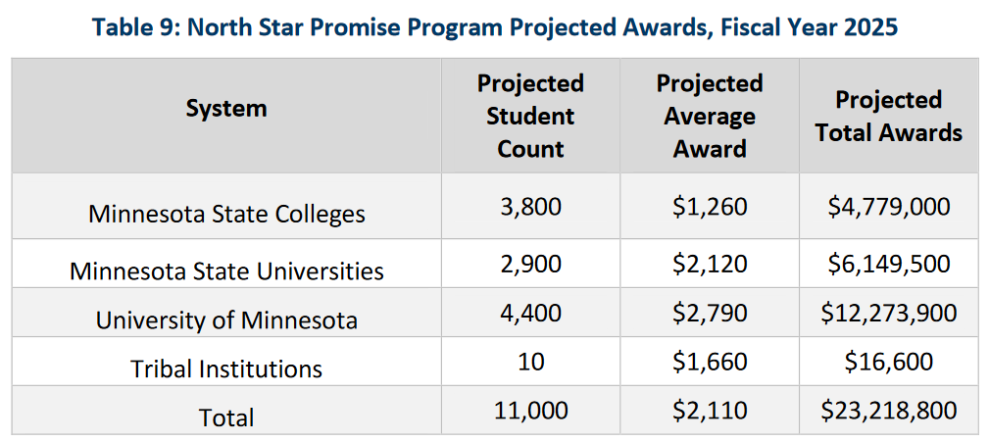
North Star Promise Scholarships
January 2024 Federal update of inflation tables increased students eligible for Pell Grants
February 2024 North Star Promise projections adjusted downward to reflect lower need
Source: Minnesota Office of Higher Education, Minnesota State Grant & North Star Promise Projections, February 15, 2024

Slide 14
Fiscal Year 2025 Proposed Revenue Fund Rates
Revenue Fund Program or Facility | FY2025 Average Rate | $ Change from FY2024 | % Change from FY2024
Room and board for traditional double room with meal plan | $9,199.00 | $394.00 | 4.5%
Student Union | $294.41 | $6.23 | 2.2%
Wellness and Recreation Facilities | $183.61 | $2.06 | 1.1%
Parking | $284.69 | $2.84 | 0.5%

Slide 15
Proposed Fiscal Year 2025 Revenue Fund Budget
$s in millions |  | FY2024 Current Budget | FY2025 Proposed Budget | $ Change | % Change
Revenues
 | Operating Revenue | $104.4 | $111.2 | $6.8 | 6.5%
 | Fund balance for 1x investments | $0 | $7.5
Total budgeted revenues |  | $104.4 | $118.7 | $14.3 | 13.7%
Expenses
 | Compensation | $26.4 | $28.7 | $2.3 | 8.8%
 | Other operating costs | $79.2 | $92.1 | $12.9 | 16.2%
Total budgeted expenses |  | $105.6 | $120.8 | $15.2 | 14.4%
Budget gap |  | ($1.2) | ($2.1)
Fund balance to balance budget |  | $2.8 | $2.8
Budget balance |  | $1.6 | $0.7
Numbers may not add due to rounding

Slide 16
Board Motion June
“The Finance and Facilities Committee recommends that the Board of Trustees adopt the following motion:
Adopt the annual total all funds operating budget for fiscal year 2025 as shown in Table 5.
Approve the proposed tuition structure recommendations and differential tuition rationale for fiscal year 2025 as detailed in Attachments 1A through 1H.
Tuition rates are effective summer term or fall term 2025 at the discretion of the president. The chancellor or designee is authorized to approve any required technical adjustments and is requested to incorporate any approvals at the time fiscal year 2025 tuition recommendations are presented to the Board of Trustees.
Continue the policy of market-driven tuition for closed enrollment courses, customized training, and non-credit instruction, continuing education, and contract postsecondary enrollment option programs.
Approve the Revenue Fund and related fiscal year 2025 fees for room and board, student union, wellness and recreation facilities, and parking ramps/surface lots as detailed in Attachments 2A through 2E, including any housing fees that the campuses may charge for occupancy outside the academic year.
Authorize the chancellor or designee to enter into an agreement with the Learning Network of Minnesota to provide the funding appropriated to the organization in Minnesota Laws 2023, Chapter 41, Article 1, Section 3, Subdivision 4, in the amount of $4,115,000.”

Slide 17
Thank you.
30 East 7th Street, Suite 350
St. Paul, MN 55101-7804
651-201-1800
888-667-2848
MinnState.edu
This document is available in alternative formats to individuals with disabilities. To request an alternate format, contact Human Resources at 651-201-1664.
Individuals with hearing or speech disabilities may contact us via their preferred Telecommunications Relay Service.
Minnesota State is an affirmative action, equal opportunity employer and educator.

