Slide 1

Minnesota Nonresident Entertainer Tax
Tax Compliance Training
August 2018
TAX SERVICES

Slide 2

Goals for Today
When to apply MN Nonresident Entertainer tax
  Campus Participation: Specific Scenarios
Where to find help:
  Tax Services, Steve Gednalske or Ann Page
  Steven.Gednalske@minnstate.edu
  651-201-1657
  Ann.Page@minnstate.edu
  651-201-1730
  Tax Services Website & SharePoint

Slide 3

MINNESOTA NONRESIDENT ENTERTAINER TAX
Entertainers who are residents of other states and perform in Minnesota are subject to Minnesota’s Nonresident Entertainer Tax.
This tax is 2 percent of the gross compensation received by a nonresident entertainer or entertainment entity.

Slide 4
WHO IS TAXED?
Nonresident:
  an individual who is not a resident of Minnesota
Entertainers:
  include, but are not limited to, musicians, singers, dancers, comedians, actors, athletes, and public speakers.
Entertainment Entities:
  An independent contractor who is paid to provide entertainment
  A partnership that is paid for entertainment provided by entertainers who are partners.
  A corporation that is paid for entertainment performed by entertainers who are shareholders of the corporation.

Slide 5

WHAT IS TAXED?
Gross Compensation:
  All compensation paid for a performance. A performance is an exhibition or presentation before an audience, such as a play, musical program or speech.
  Reimbursed expenses
  Prize winnings at spectator events.

Slide 6
EXCEPTIONS TO WITHHOLDING REQUIREMENTS
The payment made to a nonresident public speaker is less than $2000
The payment made to a nonresident entertainer or entertainment entity is less than $600.
The nonresident entertainer or entity is a resident of North Dakota or Michigan and the individual provides a properly completed Form MWR, Reciprocity Exemption/Affadavit of Residency
Not-for-profit entities that indicate their tax exempt status on Form W-9 & provide a copy of their IRS nonprofit status letter.

Slide 7
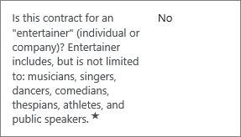

MN ENTERTAINER TAX AND MARKETPLACE
MP Contracts:
  Questions in Marketplace
  Informational only

Slide 8
MN ENTERTAINER TAX AND MARKETPLACE
Payment/Invoice:
  If Entertainer/Speaker Object codes 1910 or 1970 are used, the accounting module will ask if you wish to withhold Entertainer Tax of 2%. If tax is withheld and if the payment is from a local account a tax check will be created payable to System Office Tax Services Unit, 0000215893-
004. If tax is withheld and the payment is from a State Treasury account a payment will be made directly to Minnesota Revenue.
  In MP Withhold 2% Entertainer/Speaker Tax must be selected by editing a specific section of the Buyer Invoice by Accounts Payable.

Slide 9
MN ENTERTAINER TAX AND MARKETPLACE
To withhold MN Entertainer tax in Marketplace, select “edit” …

Slide 10
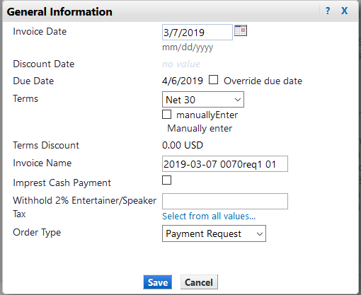

MN ENTERTAINER TAX AND MARKETPLACE
The campus then clicks on “Select from all values”…
1
1

Slide 11
MARKETPLACE AND MN ENTERTAINER TAX
The campus then clicks on “Select from all values” and selects “Yes” to withhold the tax and “Save”.
1
2

Slide 12
WITHHOLDING & REPORTING MN NRE TAX
Local Fund Payments Withholding & Reporting
  Report MN NRE tax withheld from local fund payments monthly
    Due to Tax by the 10th of the month for payments made during the preceding month
    Complete the MN NRE tax spreadsheet & send to Tax via MoveItSecurely
    Remit tax to Tax Services
– Note: check will be automatically created when using the accounting module or Marketplace. Campuses can either send the check when it prints or wait and send all withholding checks together by the 10th of the month

Slide 13
EXAMPLES
Speaker: Metropolitan State University hosts the Minneapolis St Paul International Film Festival at Founders Hall Auditorium. For the opening night film, the director of the film is present to speak about the film and to take questions from the audience. The director resides in New York City. Metro State pays the director
$3000 and reimburses his travel expenses. Metro State
must subject his speaking fee to the 2% nonresident entertainment tax.
Same scenario, but Metro pays the director $1,500 in
total. Because the payment is under $2,000, no tax withholding is required

Slide 14
EXAMPLES
Comedian: St Cloud State University hires a comedian through a talent agency to perform her comedy routine. The event is open to the campus & surrounding community. The talent agency is located in Minneapolis but the comedian is a resident of Florida. St Cloud State pays the talent agency $4,000 plus $1,000 for the comedian’s travel expenses. St Cloud State must withhold 2% nonresident entertainer tax from the entire amount paid, $5000, even though the payment is made to the agency.

Slide 15
EXAMPLES
Dancers: MSU, Mankato hires a dance ensemble from Texas to perform at the Ted Paul Theatre in Mankato. The performance is open to the public. The dance ensemble is a nonprofit organization and provides MSU, Mankato with a copy of their nonprofit status letter from the IRS. MSU, Mankato pays the ensemble $2,500. The payment is not subject to taxation due to the ensemble’s nonprofit status.

Slide 16
EXAMPLES
Speaker: Winona State University hires a public speaker from Wisconsin to give a workshop on Cultural Diversity to high school students who are attending HOPE Academic & Leadership Academy program. Because the event is part of an academic program, the entertainer tax does not apply.

Slide 17
EXAMPLES
Speaker: Fond du Lac Tribal and Community College hosts the Society for the Advancement of Native Americans in Science conference. The key note speaker is from Washington state. Fond du Lac pays the speaker $2,500 plus reimburses his travel expenses, $912. The entire amount paid, $3,412, is subject to the 2% nonresident entertainer tax.

Slide 18
EXAMPLES
Band: Minnesota State University-Moorhead hires a band from Nashville to perform two shows. The band is a partnership. All band members are partners and are residents of Tennessee. The partnership is an entertainment entity and the amount paid to the band for their performance is subject to the nonresident entertainer tax, including any reimbursed expenses.

Slide 19

Campus Real Life Scenarios?
MN NONRESIDENT ENTERTAINER TAX

Slide 20
TIPS
State in contract what portion of compensation is for public performance
  Example: Anoka Ramsey CC invites a jazz musician from California to speak and play for the Jazz Ensemble class. In addition to the classroom visit, the musician will be giving a public performance of her work at the Performing Arts Center. The contract should clearly state the amount of compensation that will be paid for each activity. When making payment ARCC only withholds on the compensation for the public performance.

Slide 21
TIPS
Business Office should be on the look out for public speaker/entertainer payments that are miscoded.
  Example: A Minnesota State college/university hosts a conference and contracts with a key note speaker for the event. Instead of using object code 1910, object code 1570, Other Professional/Technical Services, was used on the purchase order. The payment was subject to the 2% withholding even though the wrong object code was used. The campus must correct the object code in Marketplace in order to withhold the tax.

Slide 22

Tax Website – MN Nonresident Entertainer Tax SharePoint – MN Nonresident Entertainer Tax Minnesota Revenue – Fact Sheet 11

Slide 23

Questions?

