Slide 1
Title IX & Sexual Violence Investigations
April 22, 2022
Office of Equity and Inclusion
Desiree’ Clark
Office of Equity & Inclusion
Scott Goings
Office of General Counsel
Andriel Dees
Office of Equity & Inclusion
Minnesota State

Slide 2
Outline of Today’s Presentation
Review System Procedure 1B.3.1
Deep Dive on Intake Process
Forms of Discrimination
Sexual Violence Background
Neurobiological Response to Trauma
Trauma Informed Interviewing
Affirmative Consent
Intoxication verses Incapacitation
Assessing Credibility
Resources.
Questions/Discussion.

Slide 3
What Is Title IX?
Title IX is a federal civil rights law enacted to eradicate sex discrimination, in general, in all facets of the educational setting
By accepting federal funds, institutions agree not to discriminate on the basis of sex or allow the separation of the sexes in curriculum and extracurricular activities, unless permitted by the statute
Failure to comply may result in liability on the part of the institution

Slide 4
Title IX
No person in the United States shall, on the basis of sex, be excluded from participation in, be denied the benefits of, or be subjected to discrimination under any education program or activity receiving federal financial assistance.
        20 U.S.C. §1681 (1972)

Slide 5
Timeline
November 16, 2018 US Department Of Education (DOE) Notice of Proposed Rule-making.
Proposed rule officially published in the federal register on November 29, 2018.
60 Day Comment Period = January 28, 2019.
Final Rule = May 6, 2020.
Effective Date = August 14, 2020 (to incidents occurring on or after that date).
Response = revised System Procedure 1B.3.1.
BUT – Biden administration intends to announce a new regulatory proposal in April 2022.

Slide 6
Overall Process Map
Old 1B.3.1 Procedure.
  Complaint, Investigation, Decision-maker, internal appeal, Ch. 14 if serious student sanction.
New 1B.3.1 Procedure.
  Formal Complaint, Investigation (with enhanced requirements), Ch. 14, Decision-maker, internal appeal.
Also consider Policy 1B.1 and student conduct processes for non-Title IX sexual harassment and jurisdiction.
Basic legal responsibility = deliberately indifferent standard.

Slide 7
Three Quick Deliverables (or To Do’s)
Update your web-sites and information to the new System Procedure 1B.3.1.
Notice of Title IX Coordinator.
Notice of Non-Discrimination.

Slide 8
Notice of Title IX Coordinator
Each college and university must notify applicants for admission and employment, students, employees, and all unions holding collective bargaining agreements with the college or university of the name or title, office address, electronic mail address, and telephone number of the employee or employees designated at the Title IX Coordinator.

Slide 9
Notice of Non-Discrimination
Each college and university must notify applicants for admission and employment, students, employees and all unions holding collective bargaining agreements with the college and university that the college or university does not discriminate on the basis of sex in the education program or activity that it operates, and that it is required by Title IX not to discriminate in such a manner. Inquiries about the application of Title IX may be referred to the Title IX Coordinator and/or the United States Department of Education.

Slide 10
Key Elements of the New Procedure

Slide 11
Definition of Title IX Sexual Harassment
Conduct based on sex that occurs in a college or university’s program or activity in the United States that satisfies on or more of the following:
  An employee of the college or university conditioning the provision of an aid, benefit, or service of the recipient on an individual’s participation in unwelcome sexual conduct;
  Unwelcome conduct determined by a reasonable person to be so severe, pervasive and objectively offensive that it effectively denies a person equal access to the college or university’s education program or activity; or
  Sexual assault, dating, intimate partner, and relationship violence; and stalking as defined in Board Policy 1B.3.

Slide 12
Formal Complaint
Defined as
  Document filed by a complainant or signed by the Title IX Coordinator alleging Title IX sexual harassment against a respondent and requesting investigation.
  At the time of filing a formal complaint of Title IX sexual harassment, a complainant must be participating in or attempting to participate in the education program or activity of the college or university with which the formal complaint is filed.
See template.

Slide 13
Educational Program or Activity
Includes locations, events, or circumstances over which the college or university exercised substantial control over both the respondent and the context in which the Title IX sexual harassment occurred, and also includes any building owned or controlled by any officially recognized student organization of the college or university.

Slide 14
Title IX Coordinator
Employee designated by the president to coordinate the college or university’s efforts to comply with its Title IX responsibilities and Board Policies 1B.1 and 1B.3.
This does not have to be one person – can have deputy Title IX Coordinators, Investigators, etc.

Slide 15
Supportive Measures
Designed to preserve or restore a student’s access to the education program or activity, with or without a formal complaint (“non-disciplinary, non-punitive individualized services” available to both complainant and respondent).
Examples
  Academic course adjustments.
  Counseling.
  No-contact orders.
  Dorm room reassignments.
  Leaves of absences.
  Class Schedule changes.

Slide 16
Reporting
Internal Reporting = New Procedure is the same as Old Procedure (3 buckets).
  Required Reporters.
  Confidential Resources (not required to internally report).
  Encouraged Reporters.
Clarifies that reporting is to Title IX Coordinator.
New Information on External Mandatory Reporting.

Slide 17
Investigation and Resolution
Title IX Coordinator.
  Discuss options with complainant – supportive measures, referral to law enforcement, filing a formal complaint, pursuing other policy processes (1B1, student conduct, etc.)
  If formal complaint.
    Determines Jurisdiction.
    Conflicts.
    Information to complainant and respondent (see form notice of allegations).

Slide 18
Conflict of Interest
Title IX Coordinator to identify any real or perceived conflict of interest in proceeding as the Title IX Coordinator, for the decision-maker, and/or for any person designated to facilitate an informal resolution.
Assign new person.

Slide 19
Informal Resolution
School may facilitate an informal resolution process at any time before reaching a determination regarding responsibility provided that each party provides their voluntary, written consent to the process.
Any party may withdraw from informal resolution process and return to formal complaint process.
Informal resolution shall not be used to resolve allegations that an employee sexually harassed or assaulted a student.

Slide 20
Interim Actions
Employee reassignment or administrative leave.
  Discuss with HR/LR.
Student summary suspension.
No real change to prior practice = note that the regulations use the term “emergency removal.”

Slide 21
No Basis to Proceed Determinations: Title IX Sexual Harassment
Must dismiss formal complaint if:
  The conduct would not constitute Title IX Sexual Harassment, even if proved;
  The conduct alleged did not occur in the college or university’s educational program or activity;
  The conduct did not occur against a person in the United States
May dismiss formal complaint if:
  The complainant, at any time, notifies the Title IX Coordinator that they would like to withdraw the formal complaint;
  The respondent is no longer enrolled or employed by the institution; or
  Specific circumstances prevent the college or university from gathering evidence sufficient to reach a determination as to the formal complaint or allegations therein.
And Remember -- At the time of filing a formal complaint of Title IX sexual harassment, a complainant must be participating in or attempting to participate in the education program or activity of the college or university with which the formal complaint is filed.

Slide 22
Dismissals, continued
Must promptly notify both the complainant and the respondent of any dismissal.
May consider other policy avenues (1B.1, student conduct, etc.).

Slide 23
Investigatory Process
Essentially the same as the 1B.1.1 investigatory process. BUT
  Required presumption of innocence notice in notice of allegations (see template).
  Consider both inculpatory and exculpatory evidence.
  Not use questions or evidence that involve a legally recognized privilege.
  Before completing investigation report – send to both the complainant and respondent and their advisors, if any, the evidence subject for inspection and review. Both parties must have at least 10 calendar days to submit a written response to the evidence, which must be considered before completing the report.

Slide 24
Timely Completion
Timely completion after a complaint = no strict timeline.
Reasonable cause for delay includes considerations such as
  Absence of a party, an advisor, or a witness;
  Concurrent law enforcement activity;
  The need for language assistance or accommodation of disabilities.

Slide 25
Formal Hearing
If complaint not resolved then:
  Prepare investigation report; and
  Refer the matter for a formal hearing.
  At least ten (10) days prior to formal hearing, parties and advisors, receive the investigation report for their review and response (consult AAG as this should be done through the Ch. 14 process).
Formal Hearings for Title IX sexual harassment complaints conducted by the Office of Administrative Hearings.
  Notify assigned Assistant Attorney General or OGC that Ch. 14 required.
  Assigned Assistant Attorney General will initiate and arrange for the Ch. 14.
  See information sheet on Ch. 14 hearings.
  Costs.

Slide 26
Standard of Evidence
Remains preponderance of the evidence.

Slide 27
Decision-maker
ALJ prepares report and recommendation.
Decision-maker receives report and recommendation and decides
  Whether the policy has been violated; and
  On appropriate sanctions if the policy has been violated.
  Issues a written determination that includes:
    Identification of allegations;
    Description of procedural steps;
    Findings of fact supporting the determination;
    Conclusions as to responsibility and any sanctions
    Procedures for appeal.
  The required elements may be satisfied by adopting all or portions of the report and recommendation.

Slide 28
Appeals
Within ten (10) calendar days.
Both parties may appeal final decision and an appeal of a dismissal of a formal complaint.
Grounds for appeal
  Procedural irregularity;
  New evidence;
  Conflict of interest.

Slide 29
When Student Discipline Final
Either
  Date of written determination on appeal; or
  If no appeal, the date on which the appeal would no longer be timely.

Slide 30
Advisors
Process Advisors
  Both complainant and respondent may have an advisor of their choice;
  Campus will provide if either party does not have their own.
Advisors at the Ch. 14 Hearing.
  Both complainant and respondent may have an advisor of their choice.
  Campus will provide if either party does not have their own.

Slide 31
Education and Training
Any materials used to train Title IX Coordinators, investigators, decision-makers, and any person who facilitates an informal resolution process, must be made publically available on the college or university’s website.

Slide 32
Document Retention
7 years.

Slide 33
DEEPER DIVE ON INTAKE

Slide 34
Intake
Initial thoughts on jurisdiction, mandatory, and discretionary dismissals.
Explain formal complaint process for Title IX sexual harassment.
Discuss policy options with complainants.
Consider wishes of complainant but also interest of the college or university.
Remember basic legal responsibility = deliberate indifferent standard.

Slide 35
Notice of Allegations
Upon formal complaint, provide written notice to both parties including:
  Statements that:
    Respondent is presumed not responsible
    Determination of responsibility is made at the conclusion of the 1B.3.1 process
    Right to advisor of choice who may be but is not required to be an attorney
    Parties may inspect and review evidence
    Inform parties of prohibiting knowingly making false statements

Slide 36
Interim Actions - Emergency Removal
Institution may remove a respondent from the education program or activity on an emergency basis if institution:
  Undertakes an individualized safety and risk analysis;
  Determines that an immediate threat to the physical health or safety of any student or other individual arising from the allegations justifies removal; and
  Provides the respondent with notice and an opportunity to challenge the decision immediately following removal

Slide 37
Offering Supportive Measures
Non-disciplinary, non-punitive individualized services
Offered as appropriate, as reasonably available, and without fee or charge to complainant or respondent
Before or after the filing of a formal complaint or where no formal complaint has been filed

Slide 38
Offering Supportive Measures (continued)
Designed to restore or preserve equal access to education program or activity, without unreasonably burdening the other party
Includes measures designed to protect safety
  Of all parties
  Educational environment
  Deter sexual harassment
Must maintain as confidential as long as confidentiality does not impact ability of the institution to provide measures

Slide 39
Informal Resolution Option
May never require the parties to participate in an informal resolution process
May not condition enrollment/continuing enrollment, employment/continuing employment, or enjoyment of any other right on waiver of the right to an investigation and adjunction of formal complaint.
May not offer or facilitate informal resolution to resolve allegations that an employee sexually harassed a student

Slide 40
Informal Resolution (cont.)
Any time prior to determination, may facilitate informal resolution process if:
  Provide parties with written notice disclosing
    Allegations
    Requirement of the informal resolution process including circumstances when it precludes the parties from resuming a formal complaint for the same allegations
    Consequences resulting from participating in the informal resolution process, including records that are maintained and could be shared
    Obtain parties’ voluntary written consent to informal process

Slide 41
Conclusion of the Interview
Thank the complainant for bringing the issue forward
Give them your contact information in case they remember anything
Explain future procedures and timeline
Explain retaliation policy and procedure for reporting

Slide 42
Important Title IX Considerations
Use the policy provisions in place at the time of the alleged incident
Ensure decision-makers and investigators are well trained in how to evaluate and weigh evidence
Be cautious with broad language in your procedures, e.g. "every opportunity" to present evidence
Ensure impartiality and equity
Keep parties informed
Ensure both parties feel that they are being treated with dignity and respect
Ensure that the campus community is trained about retaliation
Ensure that retaliation is appropriately addressed

Slide 43
REQUIRED REPORTER TRAINING
Required Reporters should know:
How to identify and report sexual harassment and violence
How to respond to a report by addressing immediate safety, health and well-being concerns
  Discuss importance of preserving evidence
  Discuss right to file criminal complaint and complaint with school
  Know the school's position on drugs and alcohol
How to access support and emergency assistance
  On-and off-campus medical/counseling services and academic services
How to elevate the report to a centralized process (Title IX Coordinator)

Slide 44
Investigators Must Know
Campus SaVE Act: "For those involved in receiving, investigating, and adjudicating complaints: annual training on the issues relating to dating violence, domestic violence, sexual assault, and stalking and on how to conduct an effective investigation and hearing process that protects the safety of victims and promotes accountability.“
Title IX: Title IX responsibilities to address allegations of sexual harassment, how to conduct Title IX investigations, information on the link between alcohol and drug abuse and sexual harassment and violence and best practices to address that link

Slide 45
Minn. Stat. 135A.15
Requires colleges and universities to have an online reporting system (must accommodate anonymous complaints)
Requires annual training for individuals at the campus level who are responsible for responding to reports of sexual assault—including investigators and decisionmakers

Slide 46
Training to Provide
Information on working with and interviewing persons subjected to sexual violence
Information on particular types of conduct that would constitute sexual violence, including same-sex sexual violence
The proper standard of review for sexual violence complaints
Information on consent and the role drugs and alcohol can play in the ability to consent
The importance of accountability for individuals found to have committed sexual violence
The need for remedial actions for the respondent, complainant, and school community

Slide 47
Training to Provide (continued)
How to determine credibility
How to evaluate evidence and weigh it in an impartial manner
How to conduct investigations
Confidentiality
The effects of trauma, including neurobiological change
Cultural awareness training regarding how sexual violence may impact students differently depending on their cultural backgrounds
Source: 2017, Debra Weiss Ford, Managing Principal, Jackson Lewis P.C.

Slide 48
THE CLERY ACT, 1990
DISCLOSURE OF CAMPUS SECURITY POLICY AND CAMPUS CRIME STATISTICS ACT
Adopted by Congress in 1990 at the urging of Connie and Howard Clery, after the rape and murder of their daughter Jeanne at Lehigh University a year earlier
Under this statute, university policy "must encourage individuals to report all crimes to campus police and police agencies…in a timely manner"

Slide 49
THE CLERY ACT: Basics
Campus crime reporting
Timely warning notices
Emergency notifications and emergency response testing
Fire safety reporting and missing student procedures
Notices to prospective students and employees
Policy statements

Slide 50
THE CLERY ACT
CAMPUS CRIME REPORTING UNDER THE CLERY ACT
By October 1 of each year, institutions are required to publish & disseminate crime reporting statistics occurring on campus for the current calendar year and two preceding years, and a description of certain security-related policies.

Slide 51
AMENDMENTS TO THE CLERY ACT, SaVE Act
In March 2013, Congress reauthorized the Violence Against Women Act (VAWA) which imposes new obligations on colleges and universities under its Campus Sexual Violence Act ("SaVE Act") provision
Expanded list of reportable offenses
Requires adoption of student discipline procedures
Requires adoption of institutional policies to address and prevent campus sexual violence

Slide 52
AMENDMENTS TO THE CLERY ACT
On October 20, 2014 the Department of Education published the final VAWA regulations which imposed expanded obligations on colleges and universities, effective July 1, 2015:
Additional crimes of domestic violence, dating violence and stalking are added to the Clery Act
Institutions must adopt policy statements regarding sexual assault, domestic violence, dating violence and stalking which must include: educational programs for new students and employees, ongoing prevention programs, reporting procedures, institutional disciplinary procedures
Institutions must address how they complete publically available record-keeping while still maintaining the confidentiality of those who choose to report a violation
Updates to reporting obligations

Slide 53
Minnesota State Colleges & Universities
1B.1 – Covers Sexual Harassment and Other Protected Class Harassment and Discrimination
1B.1.1 – Includes the procedures for investigating and adjudicating the 1B.1 and 1B.3 cases
1B.3 – Covers Sexual Violence
1B.3.1 – Includes additional information relevant to the procedures for responding to sexual violence reports

Slide 54
Minnesota State’s 1B.1 Policy on Equal Opportunity & Nondiscrimination in Employment & Education
The 1B.1 Policy addresses:
Equal opportunity for students and staff
Nondiscrimination
Harassment
Discrimination
Protected Class
Sexual harassment
Retaliation

Slide 55
Minnesota State’s 1B.3 Policy on Sexual Violence
The 1B.3 Sexual Violence Policy addresses:
Affirmative Consent
Dating, intimate partner, and relationship violence
Non-forcible sex acts
Sexual Assault
Sexual Violence
Stalking

Slide 56
Forms of Sexual Discrimination

Slide 57
Sexual Misconduct
Non-consensual sexual contact (or attempt to commit)
Non-consensual sexual intercourse (or attempt to commit)
Sexual exploitation/Sexual Privacy

Slide 58
SEXUAL HARASSMENT: Basics
Though sexual harassment is typically addressed in the System’s 1B.1 Policy & Procedure, it can have a nexus to sexual violence (Board Policy 1B.3)
THREE KEY ELEMENTS OF SEXUAL HARASSMENT
1.Conduct that is sexual in nature,
2.That is unwelcome, and
3.That denies or limits a student's ability to participate in or benefit from a school's educational program

Slide 59
SEXUAL HARASSMENT
Under the law, a school may be liable for monetary damages for harassment by a teacher, administrator, staff member, fellow student, and/or a third party if the plaintiff can prove:
Actual knowledge by a responsible employee, and
Deliberate indifference

Slide 60
SEXUAL HARASSMENT – 1B.1
TO CONSTITUTE SEXUAL HARASSMENT, THE CONDUCT:
DOES NOT have to include an intent to harm
DOES NOT need to involve repeated incidents
DOES NOT need to be directed at a specific target
DOES NOT have to be by a member of the opposite sex

Slide 61
Sexual Harassment – 1B.1
Quid Pro Quo
  Can only be carried out by a teacher, administrator, or staff member
Two factors:
  Unwelcome sexual advances, requests for sexual favors or other verbal or physical conduct of a sexual nature; and
  Submission to, or rejection of, such conduct results in adverse educational or employment action

Slide 62
Sexual Harassment – 1B.1
Hostile Environment
Occurs when harassment is sufficiently severe, pervasive, or persistent so as to interfere with or limit a person's ability to participate in or benefit from the services, activities, or opportunities offered by an educational institution
Fact-based inquiry (Facts are isolated pieces of information, where concepts are larger ideas that show the relationships between facts)
Can be created by teachers, administrators, staff members, other students, and third parties visiting the educational institution
Can occur off campus

Slide 63
Stalking
Unwanted Phone Calls
Unwanted Voicemails
Unwanted Text Messages
Spying
Sending unwanted gifts
Letters
E-mails
Social media use
Showing up at a location

Slide 64
Relationship/Dating Violence
Physical harm or abuse
Threats of physical harm or abuse

Slide 65
Retaliation
Occurs when an adverse educational action is taken against a person because of the person's participation in a complaint or investigation of discrimination or sexual misconduct

Slide 66
Investigating Sexual Violence – Dating Violence – Stalking – Sexual Harassment
Investigators must ensure that these investigations into these complaints are:
Prompt – Completed in reasonable time frame
Thorough – Adequate information used in formal or informal investigation
Impartial – Investigators trained and no bias, including free of cultural bias

Slide 67
The Purpose of an Investigation
Conducting an investigation to allow the decisionmaker to determine:
  Based on the facts, did a policy violation occur?
  If yes, what is the appropriate sanction?
  How can the institution:
    Stop the discrimination, harassment, violence
    Prevent its recurrence
    Remedy the effects of the incident(s) on the Complainant(s) and the community

Slide 68
Know the Policies
Why is this important to an investigation?
-It helps you determine if an investigation is appropriate
*Who does the policy apply to?
*What do the terms refer to?
-It helps you frame the ultimate investigative questions in issue
-You understand the elements of a claim
-You have time to seek guidance, if needed
-You prepare for and conduct thorough interviews and minimize any unnecessary re-interviews
-You provide the decisionmaker with necessary information to make a decision

Slide 69
Sexual Violence Background

Slide 70
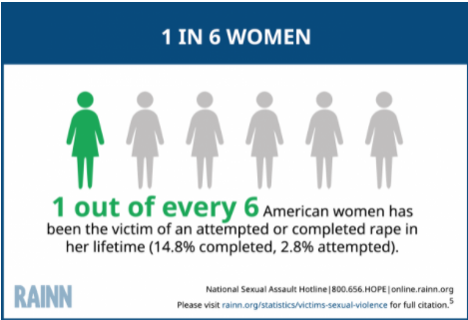
THE ISSUE OF SEXUAL ASSAULT: women

Slide 71
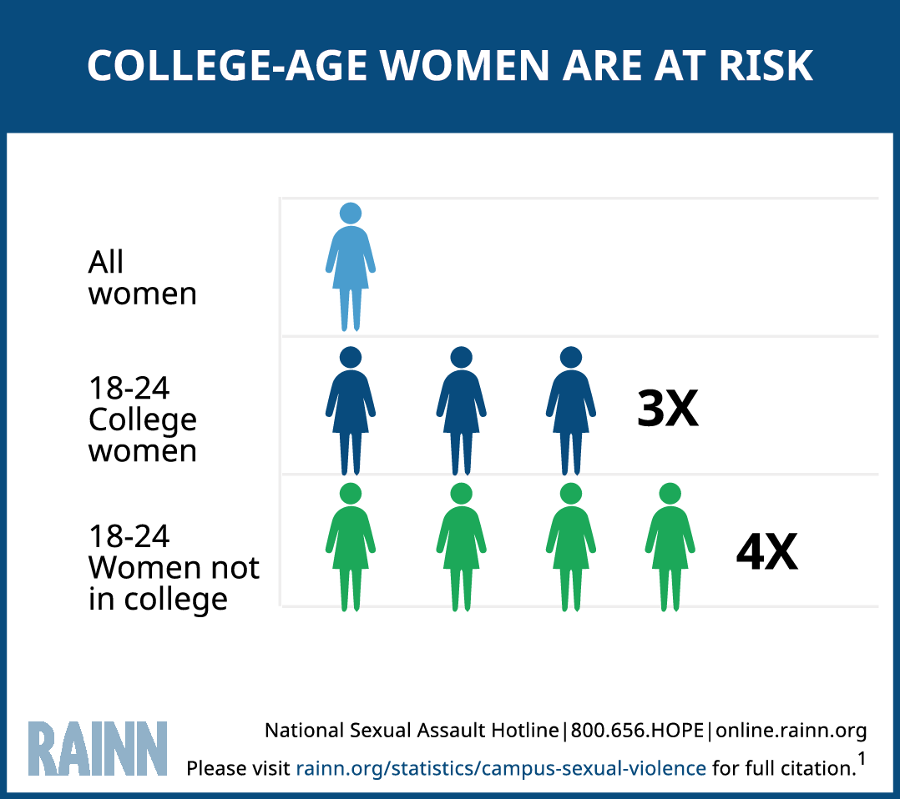
THE ISSUE OF SEXUAL ASSAULT: college-age women

Slide 72
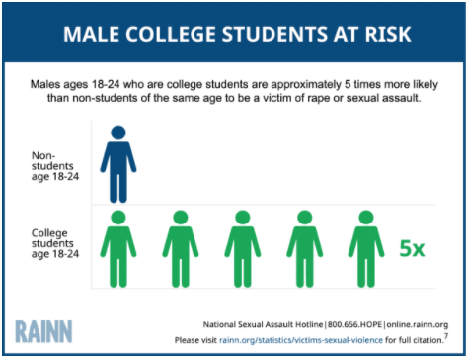
THE ISSUE OF SEXUAL ASSAULT: college men

Slide 73
THE ISSUE OF SEXUAL ASSAULT: students
13% of all students experience rape or sexual assault through physical force, violence, or incapacitation (among all graduate and undergraduate students).
21% of TGQN (transgender, genderqueer, nonconforming) college students have been sexually assaulted, compared to 18% of non-TGQN females, and 4% of non-TGQN males.
Among graduate and professional students, 9.7% of females and 2.5% of males experience rape or sexual assault through physical force, violence, or incapacitation.
Among undergraduate students, 26.4% of females and 6.8% of males experience rape or sexual assault through physical force, violence, or incapacitation.
5.8% of students have experienced stalking since entering college.
RAINN

Slide 74
THE ISSUE OF SEXUAL ASSAULT
More than 50% of college sexual assaults occur in either August, September, October, or November.
Freshmen and sophomores are at greater risk than upperclassmen (“red zone” during their first few months of their first and second semesters in college)
60% of sexual assaults of college students occurred on campus
10.3% took place in a fraternity
70% of females assaulted on campus knew their attacker
Students with disabilities experience assault 50% more frequently than students without disabilities
Sexual assault victim/survivors are more likely to suffer from depression and/or post-traumatic stress disorder, abuse alcohol and drugs, and/or contemplate suicide
RAINN

Slide 75
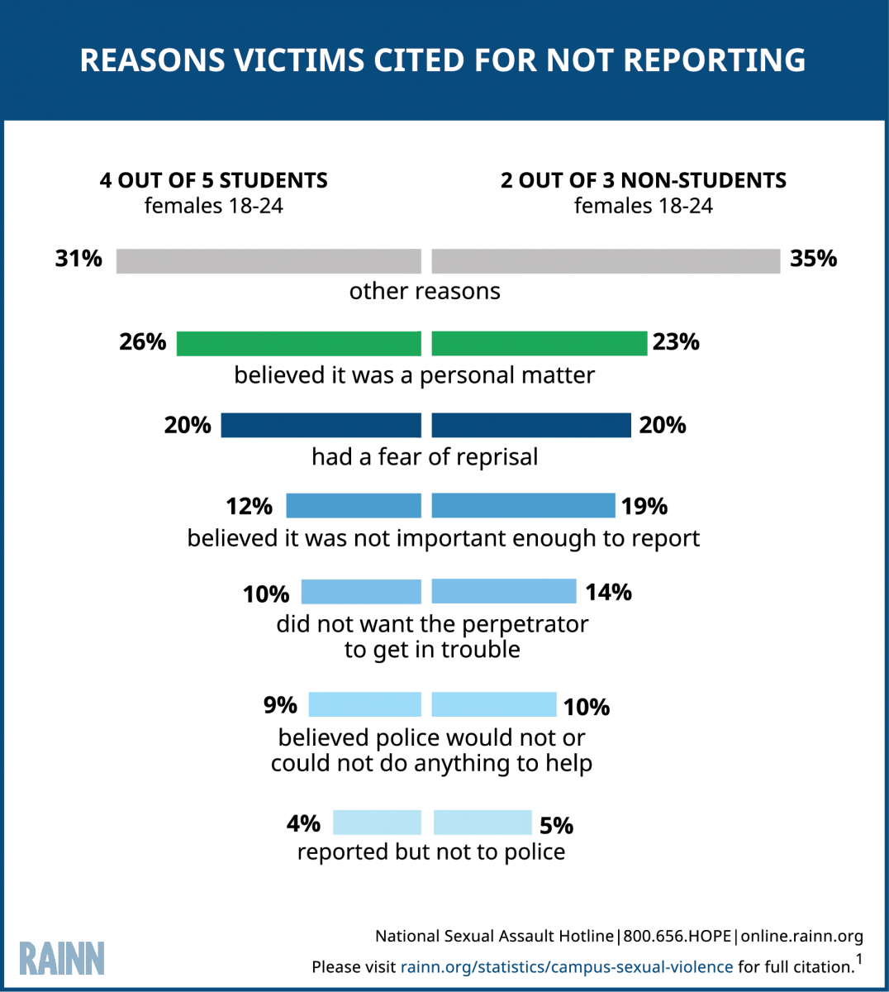
REPORTING SEXUAL VIOLENCE

Slide 76
Bias in Sexual Violence Investigations
Title IX requires a college or university to conduct a “prompt, thorough and impartial inquiry.”
Bias is defined as “to feel or show inclination or prejudice for or against someone or something.”

Slide 77
Types of Bias
Protected Category Biases (non-exhaustive list)
  Race
  Gender
  Sexual Orientation
  Gender Identity
  Religion
  Class
  Age
  National Origin
  Disability
Investigator-Specific Biases
Title IX-Specific Biases

Slide 78
Implicit Bias
What is it?
  Attitudes or stereotypes that affect our understanding, actions, and decisions in an unconscious manner
Who has it?
  Implicit biases are pervasive. Everyone possess them
  The implicit associations a person has do not necessarily align with their declared beliefs or even reflect stances they would explicitly endorse
  A person generally tends to hold implicit biases that favor their own “in” group (although research shows that people can hold biases against their own “in” group too)
Kirwan Institute for the Study of Race and Ethnicity

Slide 79
Implicit Bias: counteracting it
What can we do to counteract it?
  Implicit biases are malleable and can be unlearned
  Be conscious of the reality of implicit bias
  Be aware of our own implicit bias
    Educate yourself – Consider taking the Implicit Association Test (IAT) at implicit.Harvard.edu
  Check ourselves in our work – Be accountable
    When confronted with bias, take the time to examine your action or beliefs. Think of how you would explicitly justify them to other people.

Slide 80
Investigator-Specific Biases
Investigators are charged with finding the facts and evaluating credibility
We all have instincts, hunches, feelings, a sense about things as we investigate a case
  How much can we rely on these things?
  Does implicit bias disguise itself as these things?

Slide 81
A Wake-Up Call
Group | Accuracy
Students | .25
Prisoners | .32
Customs officers | .22
Police detectives | .22
Prison guards | .23
Patrol police officers | .24
Aldert, Vrij, & Semin (1996) | Journal of Nonverbal Behavior

Slide 82
Investigator-Specific Biases: examples
Complainant/Respondent is likeable/sympathetic
Complainant/Respondent is not likeable/sympathetic
Repeat Complainant/Respondent
Fact pattern similar to a prior, unrelated investigation
Complainant/Respondent behavior patterns

Slide 83
“One’s own culture provides the ‘lens’ through which we view the world; the ‘logic’ … by which we order it; the ‘grammar’ … by which it makes sense.”
-Avruch and Black

Slide 84
Cultural Considerations
Communication styles
Attitudes toward conflict
Approaches toward completing tasks
Decision-making styles
Approaches to knowing
Attitudes toward disclosure
  Appropriate to share emotions, reasons for conflict
                --Sue Ann Van Dermyden, 2017

Slide 85
Investigation Impact
Establishing rapport
Language may need to be altered
Storytelling style may need to be accommodated
  Linear versus circular styles
Recognize ethnocentric behaviors
  Assumption that own culture is “right” while others are “wrong”
Avoid stereotyping and assumptions
          --Sue Ann Van Dermyden, 2017

Slide 86
Confirmation Bias Examples
A person who believes that left-handed people are more creative will note every time they meet a creative person who is left handed, but will disregard or not place mental emphasis on those they meet who are right handed.
An employer who believes that a job applicant is highly intelligent may pay attention to only information that is consistent with the belief that the job applicant is highly
intelligent.

Slide 87
What other role might bias play in an Investigation?
Priming – Your pre-investigation or mid-investigation thoughts about the case
  “This is a really bad case.”
  “This person has complained three times before.”
  “This is low level.”
Phrasing – The way you ask a question can influence the answer – The misinformation effect
  Do you get headaches frequently, and if so, how often? 2.2/week
  Do you get headaches occasionally, and if so, how often? 0.7/week
  How long was the movie? 130 minutes
  How short was the movie? 100 minutes
        Headaches: Elizabeth Loftus (1975); Movie: Richard Harris (1973)

Slide 88
Sexual Violence Case Specific Biases
The subject matter of these cases is often personal and very intimate
Most of us hold our own conscious beliefs and practices when it comes to this content area and it is important not to intentionally or unintentionally cast your lens on the matters you investigate
  Your own sexual experiences
  Moral or religious views about sex
  Comfort level in using terms – subject matter

Slide 89
Alcohol and Drug Use Biases
You may have your own views on and experiences with:
  Alcohol use
  Drug use
These things may have impacted your life

Slide 90
Rape Myth Acceptance
Many studies have found that the higher the rape myth acceptance (stereotypical beliefs about rape), the more responsibility is attributed to the victim/survivor.
  The victim/survivor wanted it
  The person causing the harm didn't mean to
  Clothing
  Alcohol

Slide 91
Counterintuitive Behavior of Rape Victims
Delay in reporting
Change in account of what happened
Unexpected demeanor/disposition
Unexpected behavior
  Contact with person who caused the harm
  Resumption of normal routine
  Subsequent sexual activity (sometimes with the person who caused the harm)

Slide 92
“Delayed” Reporting
“If the victim/survivor was truly raped,
why would they wait so long to report it?!”

Slide 93
Significant Time Between Incident And Report
The norm when the person causing the harm was not a stranger
Many victim/survivors are able to report only after they receive the necessary support to do so
Why do they wait? For many of the same reasons they later recant
  They fear repercussions
  They are pressured by others not to report
  They feel shame, embarrassment
  They are afraid of the person who caused the harm
  They are afraid of not being believed
  Fear that nothing will be done about it

Slide 94
When do victims report?
A study: For non-SANE/SART cases, an average of 33 days elapsed between the time the incident occurred and the time when the victim reported the assault.
The majority of victims do not immediately report.
Source: Testing the Efficacy of SANE/SART programs: Do They Make a Difference in Sexual Assault Arrest & Prosecution Outcomes?

Slide 95
Understand the Target
Sexual offenders rely on investigators and those within our institutions to
make the same judgments about the victim/survivor, which may help the person causing the harm to get away with it . . .

Slide 96
Scenario #1
Joe and Sue broke up and Sue is not taking it very well. For the past two or three weeks she has been texting Joe and begging him to take her back. She has also shown up at Joe’s off-campus apartment and left him presents twice. Joe has made it clear that he feels bad about the breakup, but that he needs Sue to “move on”. Sue cannot seems to and continues to text, show up and call Joe. Today, Joe posted a picture on social media of him and his new girlfriend, Taylor. Sue does not take it well and calls Joe and threatens to kill herself. Joe’s roommate Chandler comes to you, the Dean of Students and reports this, but says he doesn’t want to get anyone in trouble.
Identify next steps.

Slide 97
Neurobiological Responses to Trauma

Slide 98
Why is this Important?
Recognize what a victim/survivor goes through (physically and mentally) during an assault
Understand how a victim/survivor’s brain may process information during an assault
Identify the effects trauma has on memory and a victim/survivor’s ability to recall details of an assault
(especially the way in which they are asked to do so)
Identify reasons for varying behaviors and emotions in victim/survivors following assault

Slide 99
1. Threat to life or limb;
2. Severe physical harm or injury (including sexual assault);
3. Receipt of intentional injury or harm;
4. Exposure to the grotesque;
5. Violent, sudden loss of a loved one;
6. Witnessing or learning of violence to a loved one;
7. Learning of exposure to a noxious agent; and
8. Causing death or severe harm to another.
--Wilson & Sigman, 2000
The Eight General Dimensions of Trauma

Slide 100
*Physical trauma;
*Medical trauma;
*Psychological trauma;
*Social or Collective trauma;
*Historical or Intergenerational trauma;
*Immigration trauma;
*Developmental trauma;
*Ongoing, Chronic, and Enduring trauma; and
*Vicarious or Secondary Trauma (“Compassion fatigue”)
--Brenda Ingram, 2017
Types of Trauma

Slide 101
Examples of Traumatic Events
Car accidents
Surgery
Child abuse
Divorce for young children
Community violence
Sexual abuse and assault
Domestic Violence
Diagnosis of a terminal illness
Suicide or murder of a loved one
Earthquakes, tornadoes, natural disasters
War
Violent Crime
                --Brenda Ingram, 2017

Slide 102
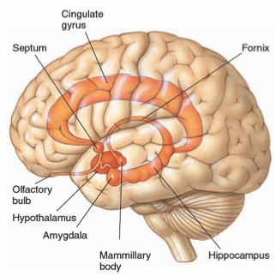
Neuroscience – The Limbic System

Slide 103
Responses of the Brain & Body During Trauma
Freeze
  Assess situation, avoid (more) attack
Flight and Fight
  Avoid (more) attack
When flight is impossible & fight useless……….
  Dissociation
    Protect from overwhelming sensations & emotions
  Tonic Immobility
    Last ditch effort to avoid (more) attack – or at least survive

Slide 104
Dissociation
Defense mechanism (of the brain) to protect against overwhelming sensations & emotions
  Occurs automatically, without trying
Portions (i.e., memories) of an experience that are normally linked together become “dis-associated”
Examples (during & immediately following a trauma):
  “Blanked out” or “spaced out” – in some way felt that I was not part of what was going on
  What was happening seemed unreal to me – like I was in a dream or watching a movie or a play
  Felt “disconnected” from my body

Slide 105
Tonic Immobility
Uncontrollable response
Mentally know what’s happening but physically unable to move (like being awake during surgery)
Rate of occurrence
  12 – 50% victim/survivors of rape experience tonic immobility during assault (most studies are closer to 50%)
  It is more common in victim/survivors with prior history of sexual assault
    Result of activation of memories of old assault plus stress hormones response activation related to new assault

Slide 106
Tonic Immobility (continued)
Caused by:
  Fear
  Physical restriction
  “Perceived” inability to escape
Occurs suddenly
  Usually after a failed struggle (escape response)
Can end suddenly
  Followed by more struggle or efforts to escape
Can last from seconds to hours

Slide 107
Memory Fragmentation
Memory recall can be very slow and difficult (or not possible)
  Memories are “fragmented” – they come only in bits and pieces (often do not follow a timeline)
  Process can be very frazzling and frustrating for victims

Slide 108
Traumatic responses can alter…
Physiology
  Heart rate, respirations, dilated pupils, dry mouth, knot in the stomach
Affective (mood and emotion) responses
  Fear, helplessness, horror
Cognitive (thought) processing
  Memory – fragmented, out of sequence
  Time distortion
  Increased confabulation
  Trauma memory and recall

Slide 109
Trauma and Memory: what we know
The body and brain react to and record trauma in a different way than we believed traditionally
Many professionals were trained to believe that even when a person experiences a traumatic event, the pre-frontal cortex records the vast majority of the event including: Who, What, When, Where, Why, and How
The Forensic Experiential Trauma Interview, Strand & Heitman

Slide 110
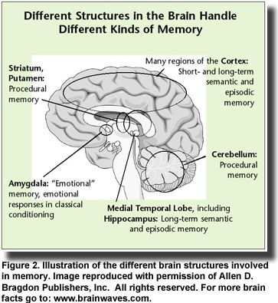
Trauma and Memory: brain diagram

Slide 111
Trauma and Memory: research
Most trauma victims are not able to accurately provide detailed information, but when asked to do so often inadvertently provide inaccurate information and details which frequently causes the fact finder to become suspicious of the information provided
Inconsistent statements are often thought of as red flags – especially in the criminal justice system—however, research shows this is not a reliable assumption when stress and trauma impact memory
--Strand, 2013

Slide 112
Memory phenomenon in traumatic situations
During trauma incident: Sensory overload, fixation on a particular aspect, miss other things
Immediately after: “post incident amnesia”—failure to remember most of what was observed
After a healthy night’s sleep: “memory recovery”—result in remembering majority of what occurred; probably most ‘pure’ recollection
Within 72 hours: final & most complete memory—but at least partially reconstructed after normal process of integrating other sources of information
By Lt. Col. Dave Grossman & Bruce K. Siddle
The Firearms Instructor: The Official Journal of the International Association of Law Enforcement Firearms Instructors
Issue 31 / Aug 2001

Slide 113
Common Victim/Survivor Behaviors to Consider
May be trying to protect others – physically, psychologically
May feel pressure from the person causing harm or others
May actually feel safer maintaining the relationship
May have some emotional/physical attachment with the person causing harm
May still be under the influence or manipulation and control of the person causing harm
May be worried about collateral misconduct – perceived or real

Slide 114
Trauma and Memory: applying science
One of the mantras within the criminal justice system is “inconsistent statements equal a lie.”
Nothing could be further from the truth when stress and trauma impact memory, research shows.
In fact, good solid neurobiological science routinely demonstrates that, when a person is stressed or traumatized, inconsistent statements are not only the norm, but sometimes strong evidence that the memory was encoded in the context of severe stress and trauma.
          --Strand, 2013

Slide 115
The Impact of Trauma on Victim/Survivor Behavior
The effects of trauma can influence behavior of a victim/survivor during an interview
People are often reluctant to recall experiences that evoke negative feelings and emotions such as anger, fear, humiliation, or sadness
--Strand, 2013

Slide 116
The Impact of Trauma: Interviewer Considerations
Interviewers should be familiar with the signs of trauma and not assume the victim/survivor is evading the truth.
Memory loss, lack of focus, emotional reactivity, and multiple versions of a story can all be signs of trauma exhibited during interviews.
For example, lack of linear memory is often a sign of trauma, so it may be helpful during initial interviews to ask, “What else happened?” instead of “What happened next?”
  --Strand, 2013

Slide 117
The Impact of Trauma: Interviewer Considerations
(continued)
Environmental barriers such as the layout of the room, the length of the interview, and the comfort of the interview room are also factors to consider.
Privacy and security may be a large concern for people who have just experienced something traumatic; therefore, the interview room should be a quiet area.
--Strand, 2013

Slide 118
The Impact of Trauma: Cultural Considerations
Cultural and language needs must be ascertained and reasonably accommodated to avoid shutdown due to culturally offensive or inappropriate approaches.
Be aware of cultural considerations of gender, subject matter, and narrative style.
Some cultures reveal a story in a circular rather than linear manner.
    --Strand, 2013

Slide 119
Trauma-Informed Interviewing

Slide 120
A Forensic Interview
A forensic interview is:
Non-leading
Victim/survivor sensitive
Victim/survivor centered
Neutral and
Developmentally appropriate that helps investigators determine what happened
--Strand, 2013

Slide 121
The Science of Forensic Interviewing
The goals of a forensic interview are to minimize any potential trauma to the victim/survivor, maximize information obtained from the victim/survivor and witnesses, reduce contamination of the victim/survivor’s memory of the alleged event(s), and maintain the integrity of the investigative process.
The Forensic Experiential Trauma Interviewing (FETI) approach is a trauma-informed interviewing approach.
--Strand, 2013

Slide 122
Initial Meeting with Complainant
Information on Retaliation
Request for Confidentiality or to Not Pursue Complaint
Transparency in the process and its limitations
Clear information about the school’s complaint resolution process versus law enforcement’s process and information/options about both

Slide 123
Initiating the Interview
Creating expectations
  Timeline
  Safe and comfortable location
  Explanation of role as a fact finder
  Explanation of need to ask a range of questions
  Recognition of awkwardness
Determine who accompanying complainant
Openness to questions at any time throughout the investigation

Slide 124
The central investigative question
What is the issue you are attempting to determine in your investigation?
For instance:
  Did Robert engage in forcible, non-consensual sexual intercourse with Susan in violation of Minnesota State’s 1B.3 policy?
  Did Sarah intentionally and without consent touch Robert’s genital area in violation of Minnesota State’s 1B.3 Policy?
  Did Professor Smith engage in stalking Professor Johnson in violation of Minnesota State’s 1B.3 policy?

Slide 125
Information You Should Obtain During the Course of the Interview
Description of the complainant’s behavior and relationship with the respondent
Description of the respondent’s behavior
Documentation of the specific incidents or acts committed and whether they were repeated
Establish whether or not there was consent
Establish whether there was force or threat of force

Slide 126
Interviewing
First, do no harm…
Any possible efforts should always be made to minimize potential further trauma to the complainant.

Slide 127
Trauma Informed Interviewing
Most investigators and decisionmakers believe when a victim/survivor experiences trauma, the brain records most of the event including the “Who, What, Where, Why, When and How," as well as other details of the event
Most investigators are trained to obtain this type of information in interviews with victim/survivors
High-stress situations can result in a trauma response on the part of the victim
Source: http://www.army.mil/article/72055/Army_expert_receives_national_recognition_for_combating_sexual_assault

Slide 128
How Does Trauma Informed Interviewing Work?
Start with one basic, open-ended question
  What are you able to tell me about your experience?
  (in your own words)
      Just let them talk (ask clarifying questions later)

Slide 129
Avoid “why” questions
Interpreted as blaming
Fear of being blamed is a huge part of why victims do not seek help
Victims are easily re-traumatized by healthcare personnel, LE, prosecution, and loved ones
Examples:
Why did you go with him?
Why didn’t you scream”
Why didn’t you kick him in the -----?
Why did you want so long to come forward?

Slide 130
Trauma Informed Interview Considerations
Engage victim in recalling memories from the event based on their personal experience and their senses
  What was your thought process during this experience?
  What are you able to remember about…..the 5 senses?
The Forensic Experiential Trauma Interview (FETI), Russell W. Strand & Lori D. Heitman

Slide 131
Continuing the Trauma Informed Interview
Gather information about the victim/survivor’s reactions during and as a result of experience
  What were your reactions to this experience?
    Physically…
    Emotionally…
      Ask them to describe and recall as many memories as possible
        Give them time
        Try to avoid probing them with additional follow-up questions at this point
  What was the most difficult part of this experience for you?
  What, if anything, can’t you forget about this experience?
The Forensic Experiential Trauma Interview (FETI), Russell W. Strand & Lori D. Heitman

Slide 132
Finalizing the Interview
Clarify any information and details gathered during interview
  This step is completed only AFTER facilitating all you can about the victim/survivor’s “experience”
  “Can you tell me more about….”
  --The Forensic Experiential Trauma Interview (FETI), Russell W. Strand & Lori D. Heitman

Slide 133
Concluding of the Interview
Thank the complainant for bringing the issue forward
Give them your contact information in case they remember anything
Explain future procedures and timeline
Explain retaliation policy and procedure for reporting

Slide 134
Evidence – comprehensive investigation
Your main goals:
  Gather all facts the complainant is able to provide about their experience and try to understand the context
  Show that you gathered all the facts from every avenue – even if you do not think it will change the outcome! Why? Your investigation will be highly scrutinized!

Slide 135
Other Witnesses
Locate any witness who may have been around the complainant or the respondent before, during, after - try to document all interactions between respondent and complainant from any witness who saw/heard the interactions.
Someone may have noticed level of intoxication, etc.

Slide 136
Other Witnesses (continued)
Since in many instances only two people saw the actual sexual assault take place, sexual assault cases allow for testimony from a broad definition of witnesses
“Ear” witnesses – overhearing corroborative statements made by the complainant or the respondent to each other, before, during, or after the alleged assault

Slide 137
Chain of Disclosure Witnesses
Interview the disclosure witnesses – what did the complainant tell to others in the first hours/days after the assault?
These are invaluable witnesses for the investigation – show the “unfolding” of the complainant’s disclosures to friends/family.
Often these people helped the complainant decide to make a complaint
How did the respondent describe to friends or acquaintances what took place between themselves and the complainant?

Slide 138
Documentary Evidence
Text messages
Videos/Photographs
Social media
Emails
Uber receipts
Key card swipe records
Police report
SART exam, medical records

Slide 139
Scenario #2
Mary has worked at Davis Community College in the Bursar’s Office for over 32 years. She recently left her husband Dave, whom she has been married for 30 years, and has filed for divorce. Dave works at Park State University up the street, in facilities , and Mary put him out because he has battered her physically for many years in addition to calling her names and withholding money from her. Mary and Dave’s daughter, Madison, contacts HR this morning because:
Dave has been drunk for 3 days and has told the kids that if he cannot have Mary, no one can.
Dave admitted to Mary that he came to Davis campus this morning and flattened her tire; and
Dave has called Mary’s cell phone today 8 times while she was working. Mary called Madison crying asking her to “make her daddy stop all of this”.
Mary is a private woman and when HR calls her in, she denies everything and says she is “fine”.
Identify next steps in this scenario.

Slide 140
Affirmative Consent

Slide 141
Affirmative Consent – 1B.3 Policy Language
What is Affirmative Consent?
Consent is informed, freely given, and mutually understood willingness to participate in sexual activity that is expressed by clear, unambiguous, and affirmative words or actions.
A lack of protest, absence of resistance, or silence alone does not constitute consent, and past consent to sexual activities does not imply ongoing future consent. The existence of a dating relationship between the people involved or the existence of a past sexual relationship does not prove the presence of, or otherwise provide the basis for, an assumption of consent. Whether the respondent has taken advantage of a position of influence over the complainant may be a factor in determining consent.

Slide 142
Who has the responsibility to obtain affirmative consent?
It is the responsibility of the person who wants to engage in sexual activity to ensure that the other person has consented to engage in the sexual activity.

Slide 143
Can affirmative consent be revoked?
Consent must be present throughout the entire sexual activity and can be revoked at any time. If coercion, intimidation, threats, and/or physical force are used, there is no consent.

Slide 144
Who cannot give affirmative consent?
If the complainant is mentally or physically incapacitated or impaired so that the complainant cannot understand the fact, nature, or extent of the sexual situation, there is no consent; this includes conditions due to alcohol or drug consumption, or being asleep or unconscious.

Slide 145
Scenario #3
Lisa and Steve are first year students at Patterson State University. They both live in Kent Hall and both on the 3rd floor. They met during orientation and hit it off. They have been dating for two weeks. Last night, an FA received a report from another resident that Lisa was crying in the bathroom. The resident states that Lisa told them that Steve kept pressuring her (Lisa) to have sex and she agreed, but only if he used a condom. Halfway through intercourse, Lisa said she noticed that Steve had removed the condom. She asked him why, and he said “The sex is way better.” Lisa let him finish but has not talked with him since. The resident thinks the FA should keep and eye on Lisa because she is really upset and disappointed at Steve.
Identify what steps should be taken.

Slide 146
Intoxication versus Incapacitation

Slide 147
Incapacitation is …
A state where a person cannot make an informed and rational decision to engage in sexual activity.
A person who was incapacitated due to the influence of drugs, alcohol, and/or medication and could not understand the fact, nature or extent of the sexual activity.

Slide 148
Determining Incapacitation
Incapacitation is a subjective determination made in light of all the facts available.
Why is it a subjective determination? Because people reach incapacitation in different ways and as a result of different stimuli (e.g., alcohol, marijuana, substance interaction with medication, etc.). They also exhibit incapacity in different ways.

Slide 149
What is the investigator evaluating?
Whether the complainant was incapacitated and, therefore, unable to give consent to sexual activity.

Slide 150
Areas of Inquiry
  Body weight, height and size;
  Tolerance for alcohol and other drugs;
  Gender
  Amount, pace and type of alcohol or other drugs consumed
  Signs of intoxication
  Food and non-alcoholic drinks

Slide 151
Incapacitation Analysis: Evaluation
Evaluating incapacitation requires an assessment of how the consumption of alcohol and/or drugs impacts an individual’s:
  Decision-making ability
  Awareness of consequences
  Ability to make informed judgments; or
  Capacity to appreciate the nature and the quality of the act.
    Occidental College Policy

Slide 152
Incapacitation Analysis
Incapacitation is a very high bar
You can be very intoxicated and still not incapacitated
--Keith Rohman, 2017

Slide 153
Assessment of Incapacitation: Obvious Indicators
Obvious indicators
  Physically helpless?
    Difficulty with motor skills, like walking
  Unable to communicate?
    Cannot communicate consent to sexual activity
    Cannot communicate unwillingness to engage in sexual activity
    --Keith Rohman, 2017

Slide 154
Assessment of Incapacitation: Other Indicators
Other indicators:
  Does the person know where they are or how they got there?
  Did the person do things in public that were out of character?
  Possible memory blackout
  Cannot verbalize coherently
  Bizarre or risky action
        --Keith Rohman, 2017

Slide 155
Assessment of Incapacitation: Counter-Indicators
Counter-indicators
  Stops to use or request birth control
  Stops to do things to prepare for sexual activity
    Brushes teeth after vomiting
    Goes to the bathroom
    Carefully removes clothing
  Carries on relatively normal conversations
  Motor abilities are not impaired
    --Keith Rohman, 2017

Slide 156
Assessment of Knowledge
If the investigator finds complainant was incapacitated, investigator must evaluate respondent’s level of knowledge of the level of incapacitation.
Assess whether the Respondent knew or reasonably should have known that the Complainant was unable to consent to the sexual activity.
--Keith Rohman, 2017

Slide 157
Assessment of Knowledge: Respondent
Respondent observed Complainant asleep or unconscious
Respondent observed Complainant unable to communicate due to physical or mental condition
Respondent observed Complainant ingest alcohol and/or drugs, rate of ingestion, time of consumption
Respondent observed Complainant’s physical and verbal behaviors
Respondent was told about the amount of alcohol and/or drugs Complainant ingested
Respondent’s actions like assisting Complainant after Complainant threw up
Respondent’s comments to others about Complainant’s state
--Keith Rohman, 2017

Slide 158
Incapacitation Analysis: Questions
1. What is the evidence that the complainant was under the influence of alcohol and/or drugs?
2. Did the alcohol and/or drugs cause the complainant to be incapacitated?
3. What did the respondent know, or what should the respondent have known, about the complainant’s level of intoxication and/or incapacitation?

Slide 159
Scenario #4
Angela and Aaron have been dating for two years at State Community College and have engaged in consensual sexual intercourse. They both live on campus. One night while become intimate, Angela stops and says she doesn’t feel like having sex that night. Aaron continues to touch her which Angela enjoys, but say that she got him excited and it isn’t fair of her to lead him on like that. Later that night they had a few alcoholic drinks and Angela says she fell asleep. She wakes up and finds Aaron on top of her having sexual intercourse. She says nothing and after intercourse tries to go back to sleep. Angela reports this to you the Director of Res Life.
Identify what steps should be taken.

Slide 160
Assessing Credibility

Slide 161
What is CREDIBILITY?
Credibility is about the believability of a party or witness (sometimes about a piece of evidence)
It is an assessment of the evidence/facts using a set of factors as tools
Caution: We are investigating on a preponderance of the evidence standard. It is important to acknowledge how this is different from determining the truth or who is lying. Even a criminal standard—beyond a reasonable doubt, which is much higher does not purport to determine the truth. Including the words truth, lie, or variations, is a misnomer and clouds the standard we are applying.

Slide 162
When and Why USE CREDIBILITY
EVERY investigation requires a credibility assessment – the length and depth of that assessment varies based on other factors in the investigation
Why?
  Demonstrates the investigator’s impartiality
  Ensures the investigator knows the case in detail
  Provides extra information/added value for the decisionmaker
  Creates a stronger report

Slide 163
Comprehensive Consideration
Put every credibility factor in your report template.
  Corroboration/Lack of Corroboration
  Consistency/Lack of Consistency
  Actual Knowledge
  Inherent Plausibility
  Motive to Falsify
  Material Omission
  Past Record
Consider each factor as you work through the evidence collected.
Delete the ones that do not apply.
--Sue Ann Van Dermyden, 2017

Slide 164
Corroboration
Is there testimony from a party or witness, or a piece of physical or documentary evidence that corroborates the party’s or witness’ testimony? Did the party or witness contemporaneously document or report the incident(s) in some way?
What to do in party said versus party said situations? Is corroboration required? Can there be a preponderance of the evidence without corroboration?

Slide 165
Consistency
Is there party or witness testimony or physical evidence that is consistent with the party’s or witness’ testimony?
Example: Complainant said he and Respondent went to a party at ABC House around 9 p.m. Friday night. Respondent said she went to a party with Complainant and Witness B on Friday night. There is an Uber receipt confirming a ride from the address of the party to Witness B’s apartment.

Slide 166
Actual Knowledge
The extend of the interviewee’s opportunity to perceive matters about which they testified.

Slide 167
Inherent Plausibility
Is the testimony believable on its face? Does it make sense?

Slide 168
Inconsistent Statements in a Trauma Environment
Recall Trauma Effects
  Memory loss, lack of focus, emotional reactivity, lack of accurate and detailed information, non-linear stories, and multiple versions of a story can all be signs of trauma
  Trauma victims may have an interrupted memory process
  Trauma victims reluctant to recall experiences that evoke negative feelings
  Lack of linear memory is often a sign of trauma
  --Brenda Ingram and Sue Ann Van Dermyden, 2017

Slide 169
Trauma effects continued
Inconsistency by trauma victim is the rule
The more confused the victim, the more likely they experienced trauma
Additive stories with more details over time does not harm credibility
Inconsistent statements do not equal a lie
Wildly varying stories more challenging
Weigh material vs. immaterial inconsistencies appropriately
--Brenda Ingram and Sue Ann Van Dermyden, 2017

Slide 170
Additional factors
Motive to falsify. Did the person have a reason to lie? Does the person have a bias, interest, or other motive? Consider relationships, history, context.
Material omission. Did a party omit a material piece of evidence, despite having a reasonable opportunity to provide it?
Past record. Does the Respondent have a history of similar behavior in the past? Does the Complainant have a relevant history?
--Sue Ann Van Dermyden, 2017

Slide 171
Caution!
Reputation. Does the interviewee have a reputation for honesty or veracity or their opposite?
Attitude. Did the person cooperate when participating in the interview and/or providing information?
Demeanor. Did the person seem to be telling the truth or lying (and why)?
--Sue Ann Van Dermyden, 2017

Slide 172
Minnesota State Contact Information
Office of Equity and Inclusion (OEI)
http://www.minnstate.edu/system/equity/
Office of General Counsel (OGC)
http://www.minnstate.edu/system/ogc/

